Slide 1
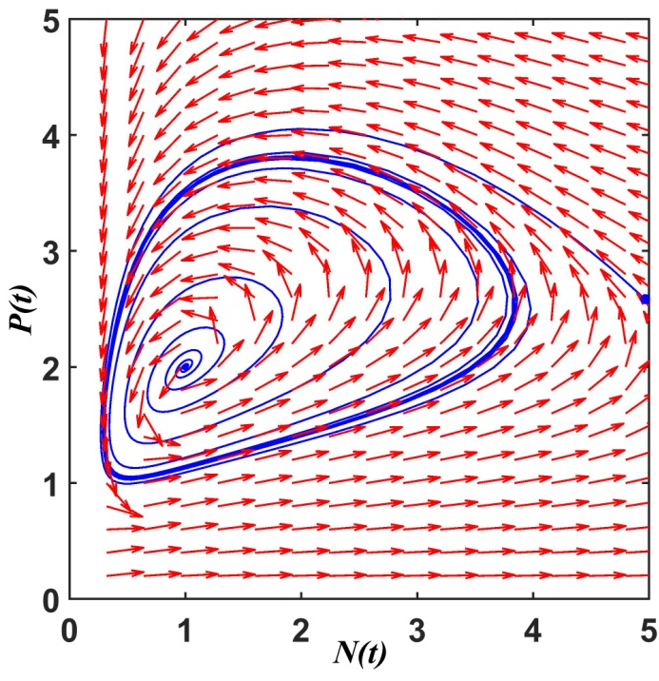
REPASO
Los modelos predador-presa de Lotka-Volterra realistas (con respuesta Holling II o III) los podemos pensar como el modelo LBJ de pastoreo tal que en el consumo se incluye a la densidad del predador.
Vimos que el modelo de Holling-Tanner:
It turns out that the above modified Lotka-Voleterra predator-prey equations with functional responses of Hollong type II or III exhibit stable limit cycle oscillations
A limit cycle solution is a closed trajectory in the predator–prey space which is not a member of a continuous family of closed trajectories such as the solutions of the original Lotka-Volterra predator-prey depicted in Figure 1.6.
Figure 1.10. Limit cycle for the Holling-Tanner model, i.e. dP/dt = sN(1-hP/N) for the predator and with parameters given by r = 1, K = 7, c = 6/7, h = 1, s = 0.2, h = 0.5.
Rather, it is an isolated periodic orbit (the thick closed curve shown in Figure 1.10), such that any small perturbation from this trajectory decays to zero.

Slide 2
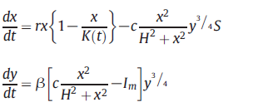
This limit cycle persists for a range of parameter values.
And, its name is because it also attracts orbits that occur at nearby initial conditions, as shown in Figure 1.10 for the Holling Holling-Tanner model.
For two different initial conditions, one inside and the other outside the limit cycle, the phase trajectories spiral into it.
El modelo PPGL (prey-predator grassland livestock) que expuso Francisco Dieguez en la clase pasada tiene este tipo de ciclos l’imite:
This modified Lotka-Volterra predator-prey model includes a variable carrying capacity and a Holling type III consumption to model extensive livestock farming:
The seasonal variation in the carrying capacity operates as an external periodic forcing which stabilizes the oscillations, after a transient lasting around three to four years, with a periodicity of 365 days.

Slide 3
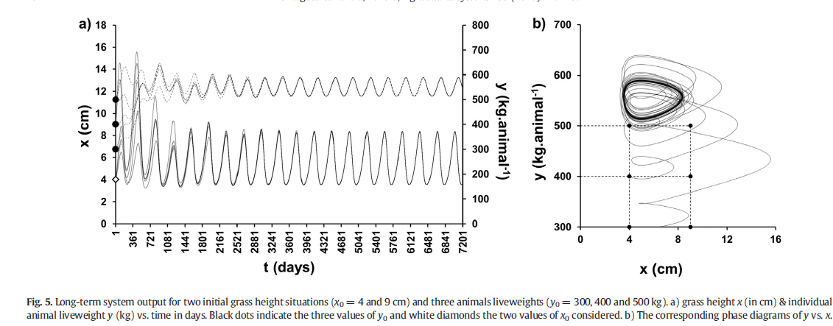
For long-term simulations we show in Fig. 5-a the co-evolution of x and y variables for two grass height initial conditions (x₀=4 and 9 cm) and three animal initial liveweight (y₀ = 300, 400 and 500 kg).
After a transient, independent of the initial conditions, both variables reach a forced annual cycle around equilibrium values x* ≅ 5 cm, i.e. coinciding with the maintenance grass height x_{m}, and y* ≅ 546 kg, a liveweight which is near the adult bovine weight for breeder systems in Uruguayan extensive livestock grassland farming (indeed this equilibrium can be computed analytically).
Another standard way to visualize the convergence to a forced cycle around the x* = x_{m} = 5 cm and y* = 546 kg when starting from different initial conditions is the phase space, i.e. by plotting y vs. x, as shown in Fig. 5-b.

Slide 4
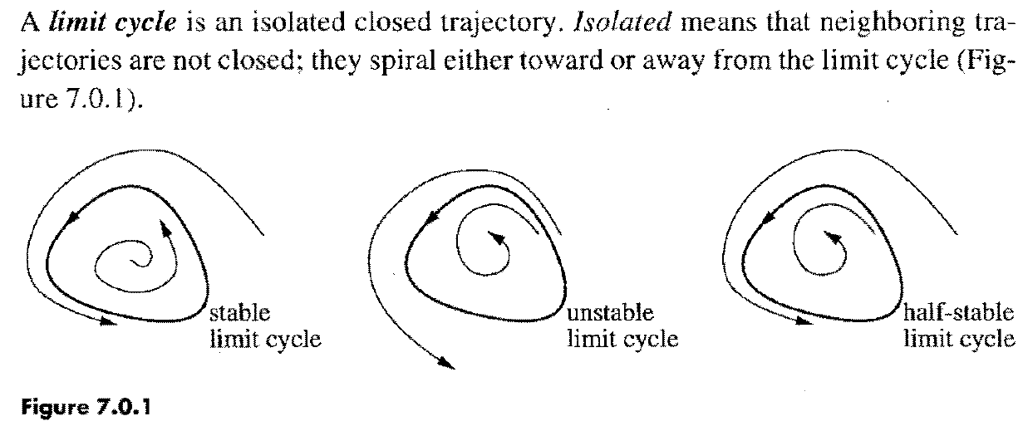
3.3 CICLOS LIMITE (Strogaz Cap. 7 textual)
If all neighboring trajectories approach the limit cycle, we say the limit cycle is stable or attracting. Otherwise the limit cycle is unstable, or in exceptional cases, half-stable.
Stable limit cycles are very important scientifically-they model systems that exhibit self-sustained oscillations. In other words, these systems oscillate even in the absence of external periodic forcing.
Of the countless examples that could be given, we mention only a few: the beating of a heart; the periodic firing of a pacemaker neuron; daily rhythms in human body temperature and hormone secretion; chemical reactions that oscillate spontaneously; and dangerous self-excited vibrations
in bridges and airplane wings

Slide 5
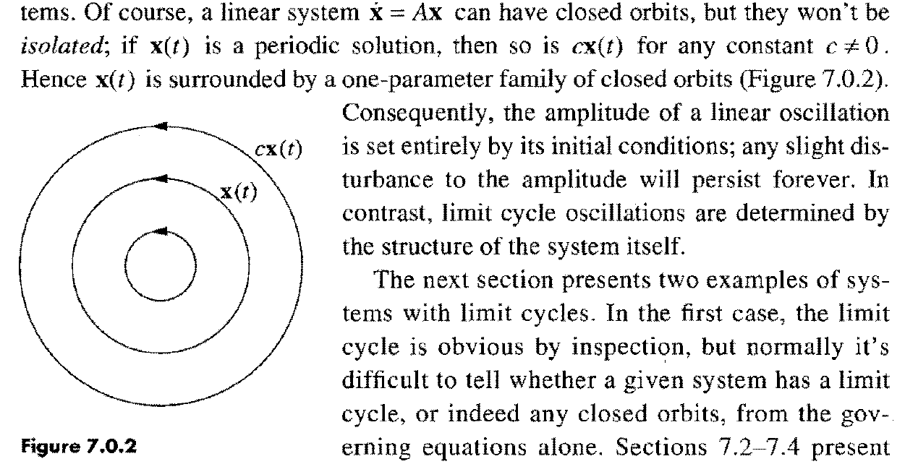
In each case, there is a standard oscillation of some preferred period, waveform, and amplitude.
If the system is perturbed slightly, it always returns to the standard cycle.
Limit cycles are inherently nonlinear phenomena; they can't occur in linear systerns.

Slide 6
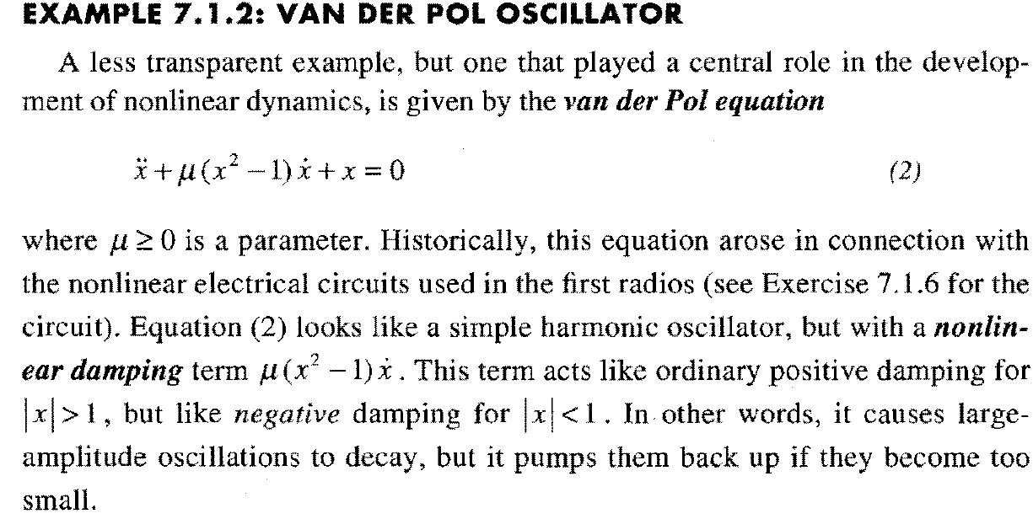
As you might guess, the system eventually settles into a self-sustained oscillation where the energy dissipated over one cycle balances the energy pumped in.
This idea can be made rigorous, and with quite a bit of work, one can prove that the van der Pol equation has a unique, stable limit cycle for each μ > 0.

Slide 7
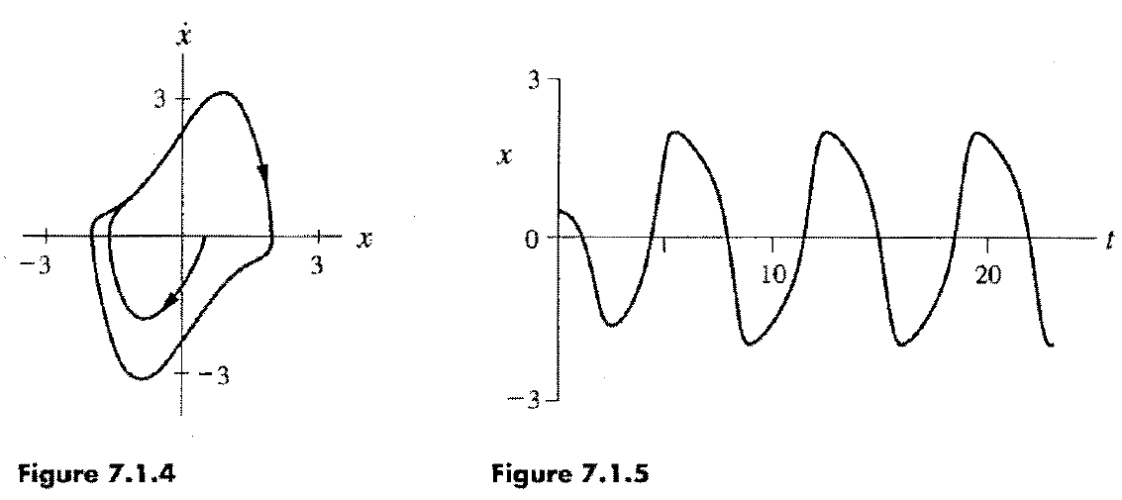
To give a concrete illustration, suppose we numerically integrate (2) for μ = 1.5, starting from (x,dx/dt) (0.5, 0) at t =0.
Figure 7.1.4 plots the solution in the phase plane and Figure 7.1.5 shows the graph of x(t).

Slide 9
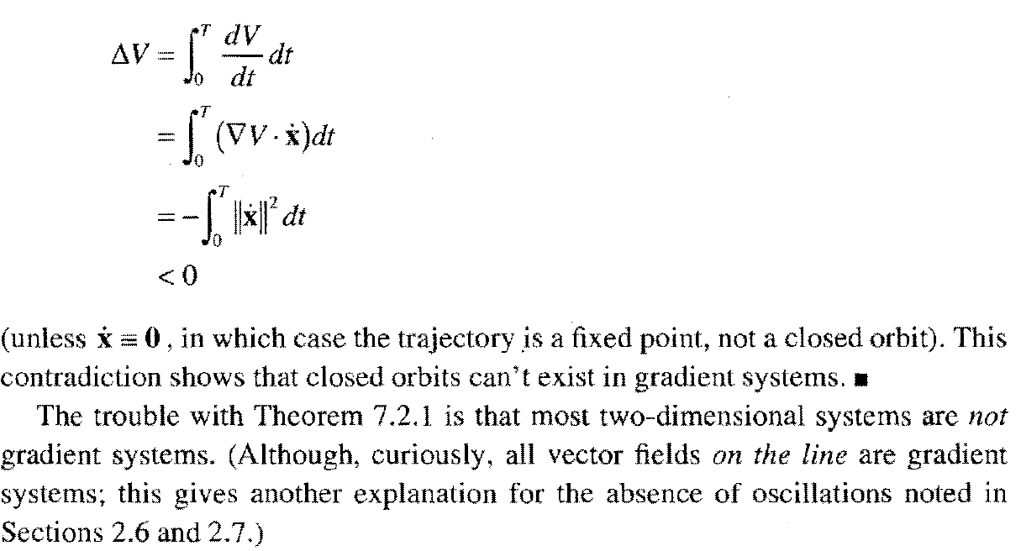
ATENCIÓN: Lo que sigue de esta sección no pretendo que todos lo entiendan en detalle, ya que requiere de conocimientos de topología.
Simplemente lo incluyo por completitud y para aquellos que les interesa vean como analizar el problema de los ciclos límites, que sin ser demasiado difícil, implica analizar con cierto cuidado.
(Pongo ese material en color naranja para que lo tengan en cuenta. )

Slide 10
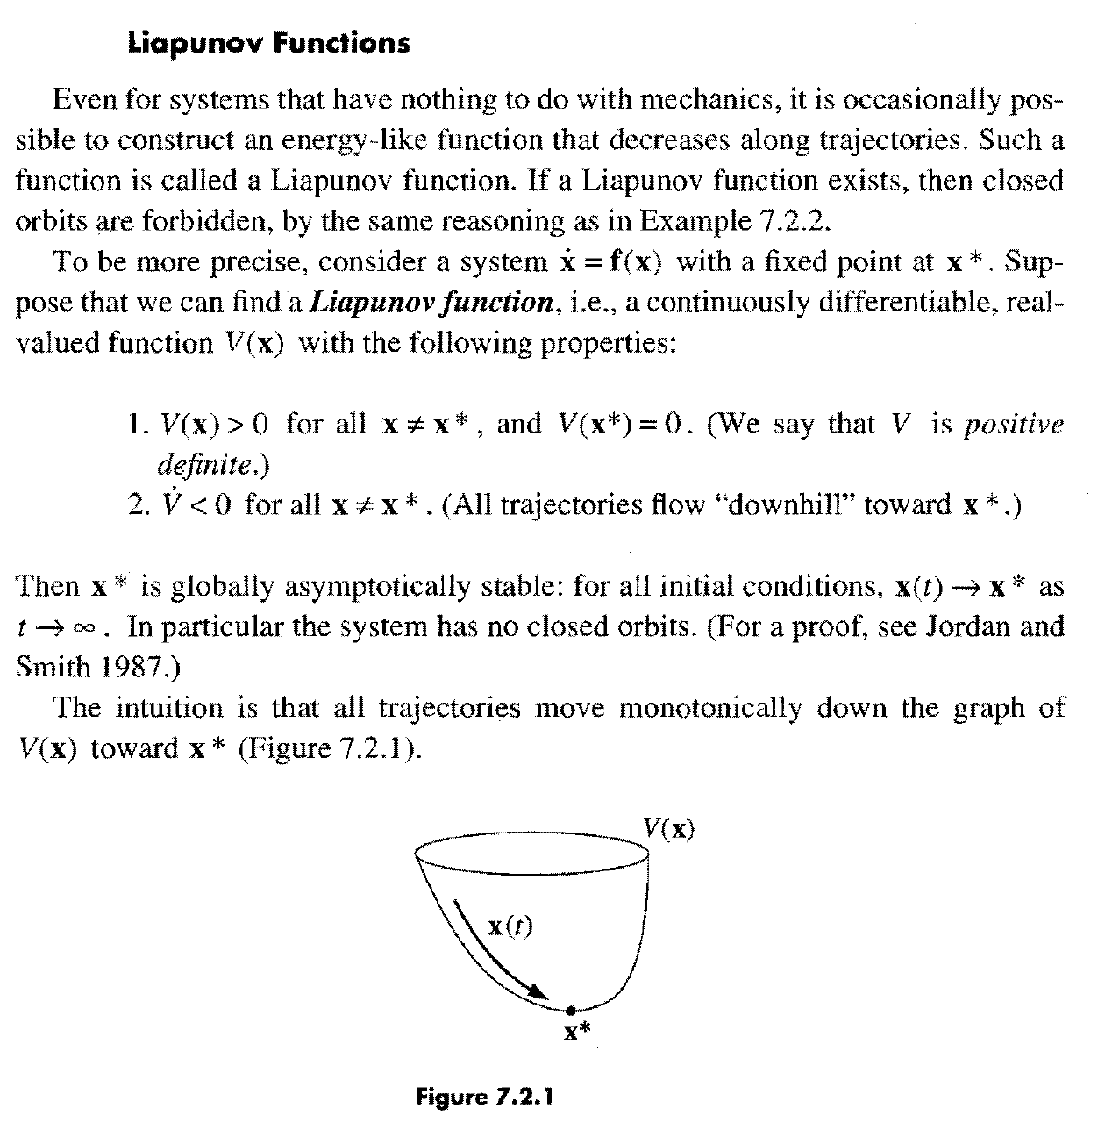

Slide 11
Unfortunately, there is no systematic way to construct Liapunov functions. Divine
inspiration is usually required, although sometimes one can work backwards.
Sums of squares occasionally work, as in the following example.

Slide 13
ogy. For details, see Perko (1991), Coddington and Levinson (1955), Hurewicz
(1958), or Cesari (1963).

Slide 14
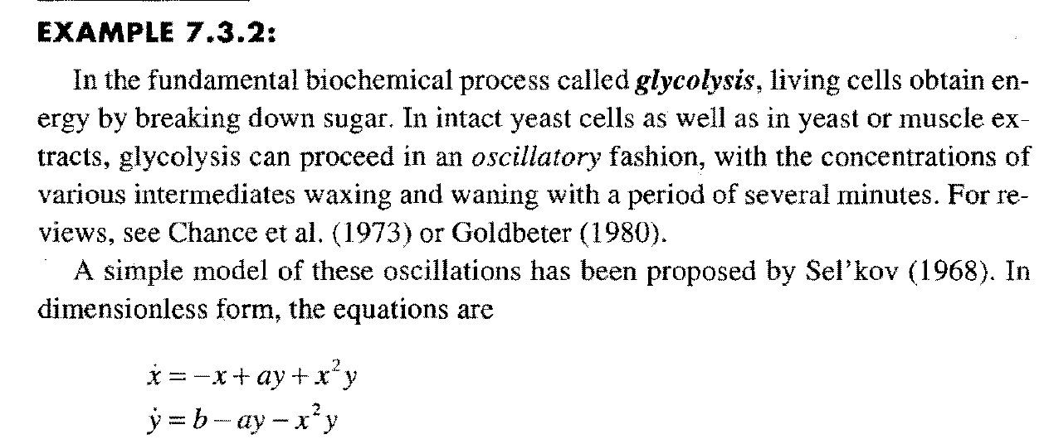

Slide 16
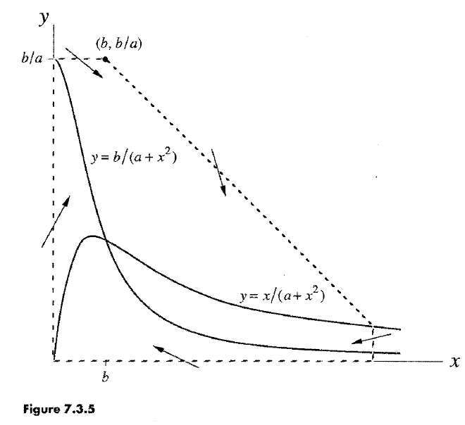

Slide 17
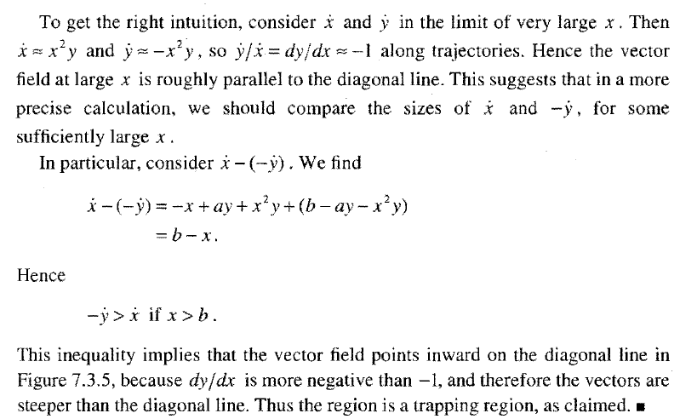
Can we conclude that there is a closed orbit inside the trapping region? No!
There is a fixed point in the region (at the intersection of the nullclines), and so the conditions of the Poincare-Bendixson theorem are not satisfied.
But if this fixed point is a repeller, then we can prove the existence of a closed orbit by considering the modified "punctured" region shown in Figure 7 .3.6. (The hole is infinitesimal, but drawn larger for clarity.)

Slide 18
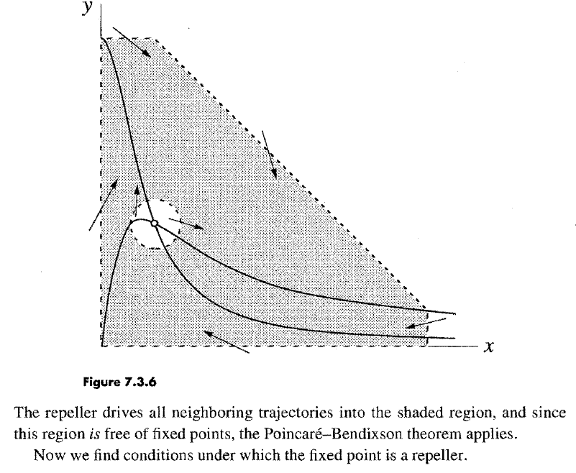

Slide 19
3.4 BIFURCACIONES EN DOS DIMENSIONES (Strogaz Cap. 8)

Slide 20
In the x-direction we see the bifurcation behavior discussed in Section 3.1, while in the y-direction the motion is exponentially damped.
Figure 8.1.1
Even after the fixed points have annihilated each other, they continue to influence the flow-as in Section 4.3, they leave a ghost, a bottleneck region that sucks trajectories in and delays(*) them before allowing passage out the other side.
(*): Se puede ver que the time spent in the bottleneck generically increases as (μ – μ_{c})^{-1/2}.

Slide 21
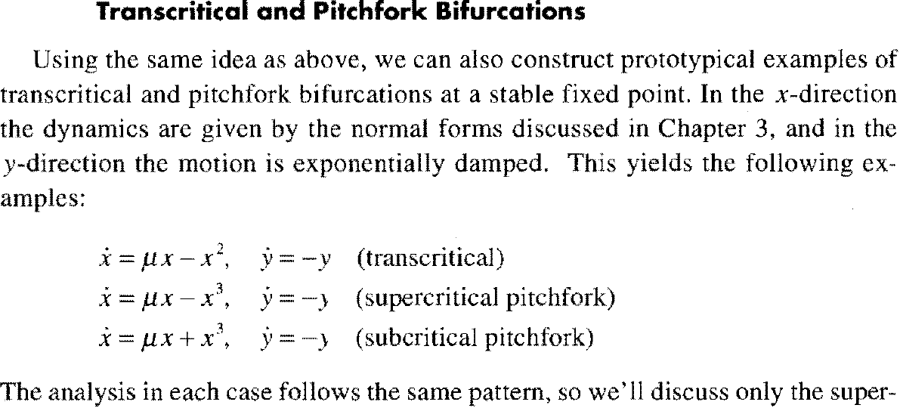
de modo que no los discutiremos.

Slide 22
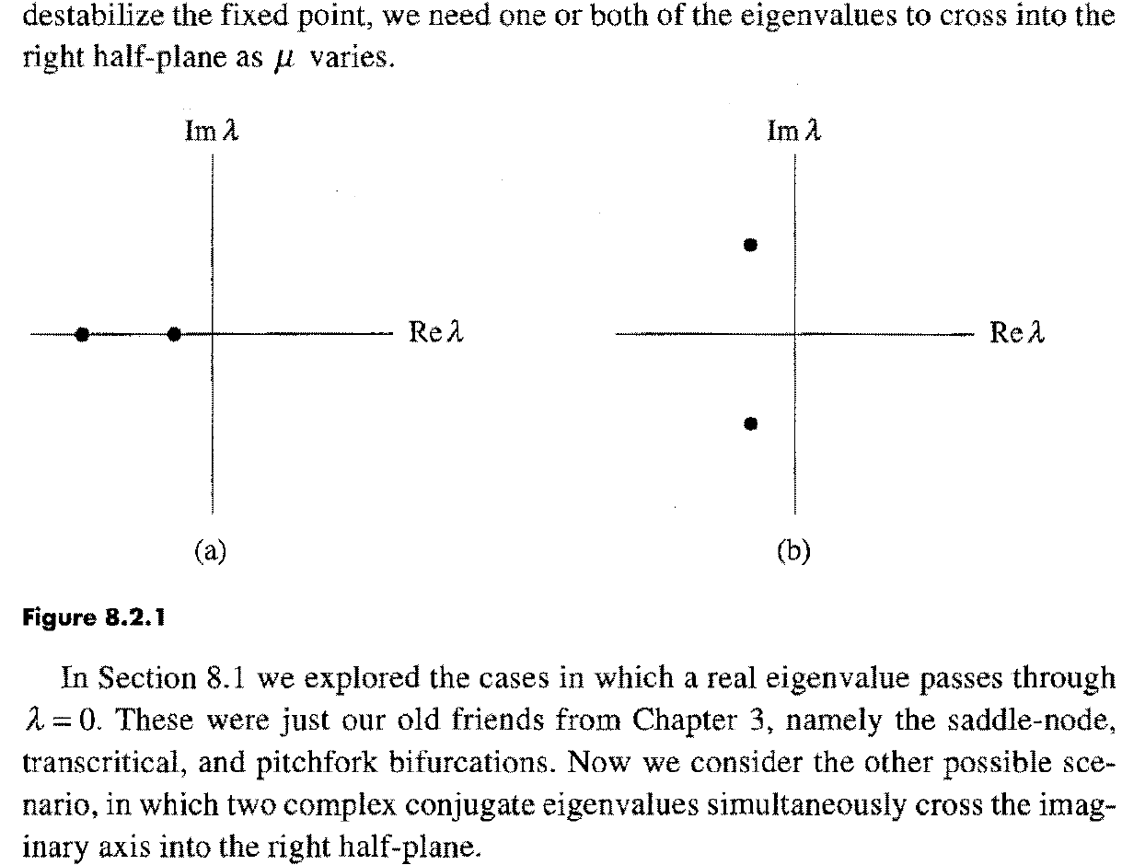

Slide 24
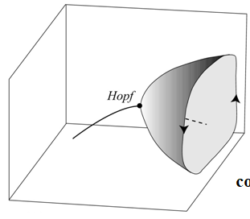
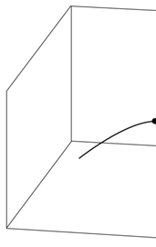
Es más claro visualizarlo en 3 dimensiones:
Para los diferentes valores del parámetro tenemos diferentes puntos de equilibrio y al variar el parámetro en un rango va describiendo una curva:
presa
presa
consmidor
parámetro
consmidor
parámetro
Súbitamente, para un valor del parámetro se pierde la estabilidad y comienza un ciclo de oscilación, esa es una bifurcación de Hopf, como muestra la figura.

Slide 25
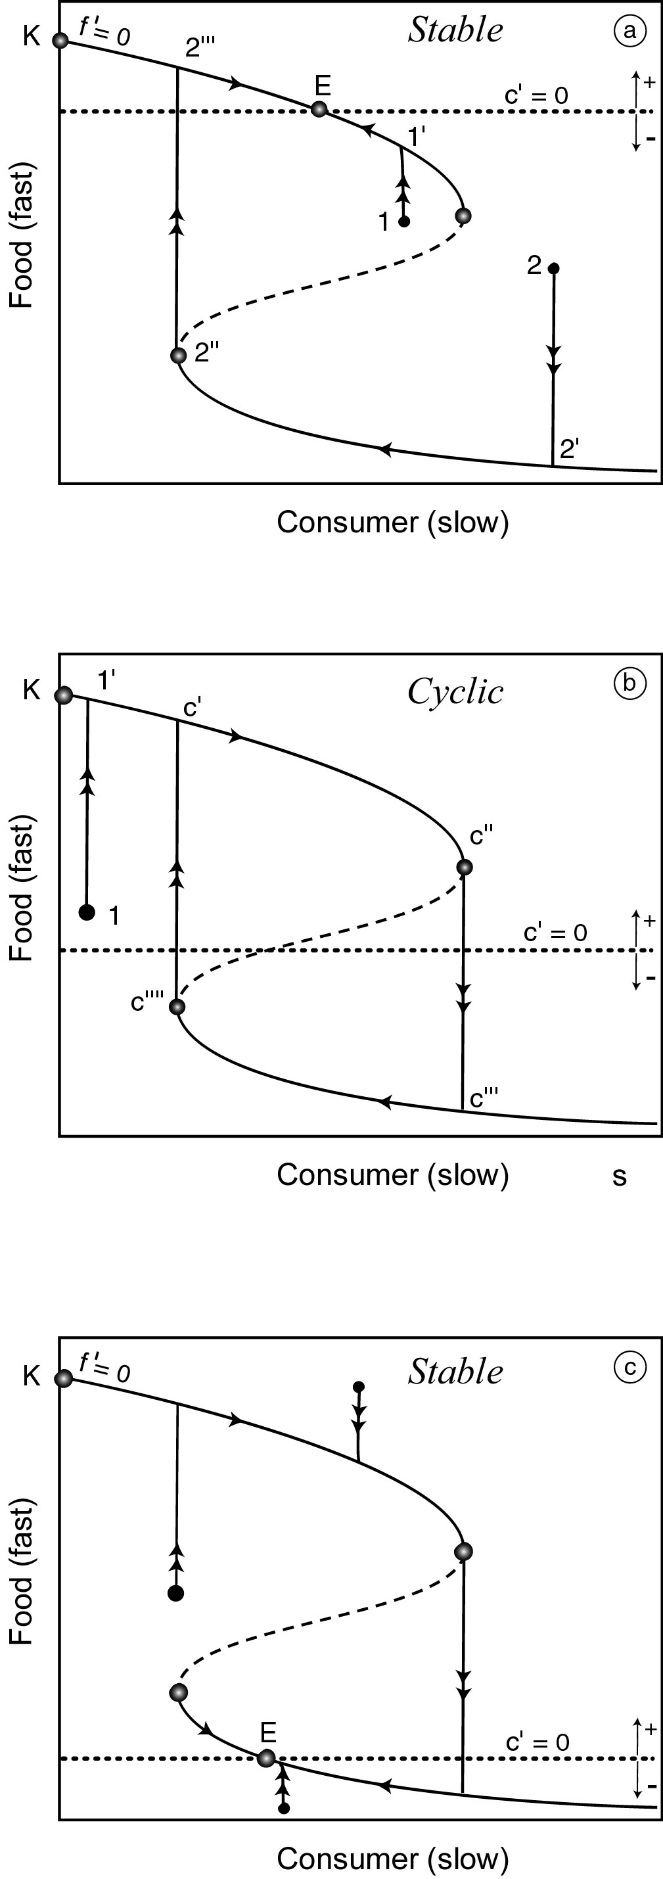
Vimos que un modelo de Lotka-Volterra realista (con respuesta Holling II o III) lo podemos pensar como el LBJ de pastoreo en el que el consumo incluye a la densidad del predador nos ayuda a entender esto.
Diferentes parámetros pueden afectar la estabilidad.
Dos de particular interés en la práctica son: la productividad de la presa y la eficiencia del consumidor.
La productividad a menudo depende de la riqueza de nutrientes que afecta la capacidad de carga de la población de alimentos (K).
Puede verse en los gráficos que un aumento en K puede cambiar un sistema de estable (panel a) a inestable (panel b). Ésta es la famosa paradoja del enriquecimiento.
El momento crucial es cuando el punto de inflexión de la derecha en la curva de equilibrio plegada de la presa cruza a la línea de equilibrio horizontal del consumidor.
Esto cambia el comportamiento asintótico del sistema de forma cualitativa:
Un punto estable se convierte en un ciclo. Este punto crucial de desestabilización se conoce como "bifurcación de Hopf".

Slide 26
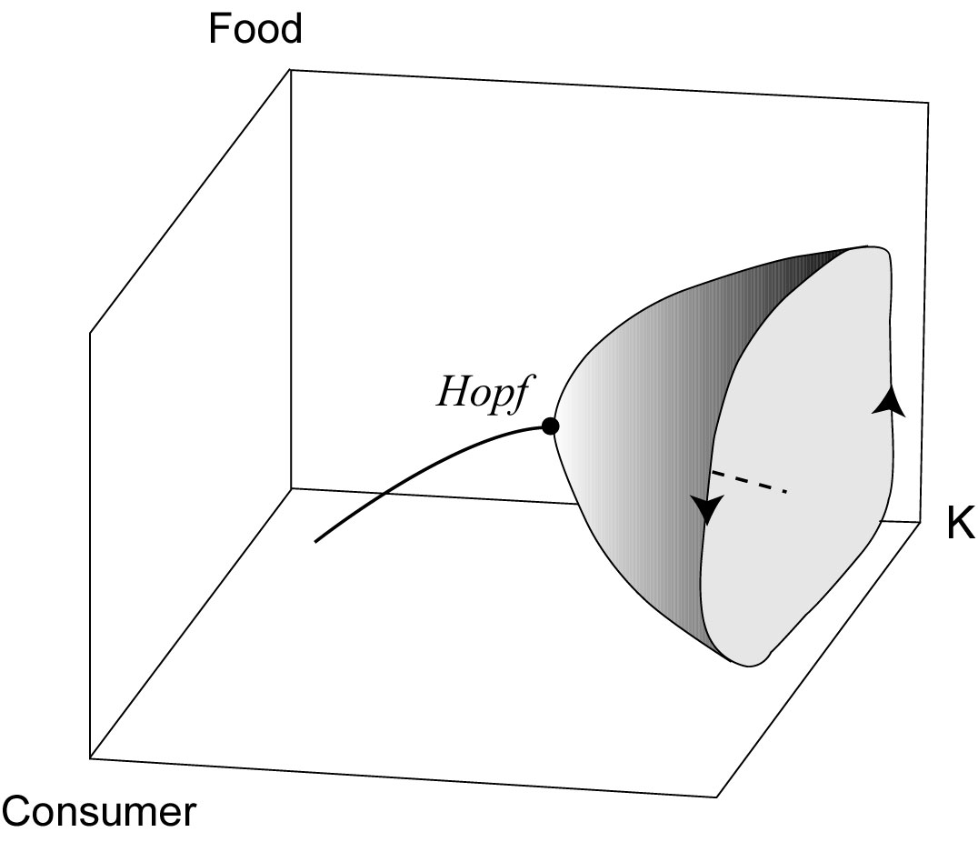
the cycle usually begins small, and then rapidly grows to a larger size (Fix xx4).
Figure xx4. Schematic representation of a Hopf bifurcation marking the change from a stable equilibrium to a cyclic attractor evolving around the equilibrium point that has now become unstable. This particular example illustrates how enrichment (increase in the carrying capacity K) can destabilize a consumer-food system, a phenomenon known as ‘the paradox of enrichment’.

