Slide 1
  5.4 SEÑALES DE ALERTA TEMPRANA DE TRANSICIONES CATASTRÓFICAS
En el Capítulo 2 (clase 3) vimos que:
Las condiciones externas de muchos sistemas cambian gradualmente sin que ocurran cambios notables hasta que cuando algún parámetro clave supera un valor umbral se produce lo que se llama un cambio catastrófico: el sistema ‘salta’ repentinamente de un equilibrio a otro cualitativamente muy diferente (sin habernos dado señales obvias).
Ejemplos de cambios catastróficos:
Transiciones de fase, como por ejemplo agua líquida supercalentada a vapor.
Colapso de estructuras en ingeniería civil (puentes, edificios, etc.)
En aerodinámica, la entrada en pérdida de un avión al variar las condiciones del ala respecto al fluido (aire).
El cambio de estado de los ecosistemas, por ejemplo la desertificación.
Nos concentraremos en d).
Las condiciones externas de los ecosistemas como el clima, los aportes de nutrientes o sustancias químicas tóxicas, la recolección o la pérdida de diversidad de especies a menudo cambian gradualmente con el tiempo.
El estado de algunos ecosistemas puede responder de manera suave y continua a tales tendencias.

Slide 2
Otros ecosistemas pueden ser bastante inertes en ciertos rangos de condiciones y de repente responder de manera muy drástica cuando las condiciones se acercan a un cierto nivel crítico.
Esto es típico de muchos sistemas no lineales en los que una variación de ciertos parámetros puede causar diferentes tipos de bifurcaciones.
Los equilibrios pueden aparecer o desaparecer, o cambiar de atraer a repeler y viceversa, lo que lleva a un cambio de un estado estable a otro radicalmente diferente, del cual la recuperación puede ser muy difícil.
Es decir, para determinadas condiciones ambientales, el ecosistema tiene dos estados estables alternativos (utilizaremos los términos atractores o equilibrios como sinónimos de estados estables), separados por un equilibrio inestable.

Slide 3
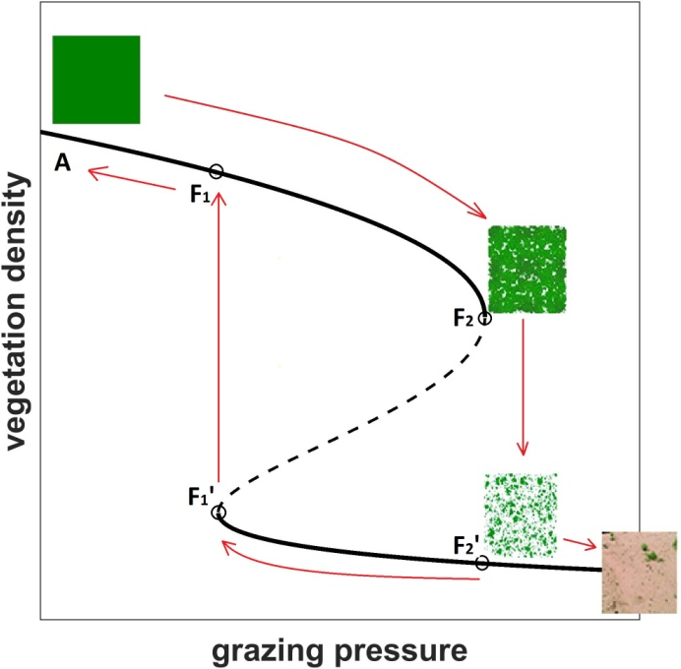
Un ejemplo que vimos de cambio catastrófico fue la desertificación de las tierras áridas sometidas a sobrepastoreo (overgrazing).
Overgrazing is regarded as one of the major causes of desertification
Fig. 4.1 shows how the vegetation density decreases as a result of the grazing pressure in drylands.
At first, increasing the grazing pressure from point A has no dramatic consequences.
When we reach point F₁, in addition to the stable 'high‘ vegetation equilibrium two additional equilibria appear out of the blue;
an unstable equilibrium (dashed line) and another stable 'low' vegetation equilibrium.
However, the system remains in its upper equilibrium branch without providing any significant warning signal (we only observe a gradual decrease in the vegetation density).
If we continue increasing the grazing pressure, when we reach point F₂ the 'high' vegetation equilibrium disappears. Thus, at this point, a sudden steep drop of the vegetation density towards the only remaining stable 'low' vegetation equilibrium takes place (from F₂ to F₂').
In fact, we will see later that the transition from one attractor to the other can occur before we reach the 'point of no return' F₂, somewhere between F₁ to F₂.

Slide 4
Luego, en la clase 4 del Capitulo 2 vimos que las transiciones catastróf-icas, si mirábamos con cuidado, nos daban algunas señales de alerta temprana:
Catastrophic Shifts fingerprints
Catastrophes have characteristic fingerprints or ’wave flags’. Let us
compare some of these flags for the desertification by overgrazing vs. the vaporization:
Modality (2 definite ASS): the grazing model has the high and low vegetation states, similarly the fluid in the neighborhood of the liquid–gas coexistence curve, having well defined liquid and gas states.
Sudden jumps: like in the fluid, since there is an abrupt increase in volume when a liquid (high density vegetation) transforms into vapor (low density vegetation).
However, this large change in volume occurs when a slight change in the temperature and pressure moves the fluid from one side of the coexistence curve to the other. That is, the liquid–gas coexistence curve can be identified with S_{M} and the changes of state obey in general the Maxwell convention.
On the other hand for the ecological model the transition tends to follow the Delay convention.

Slide 5
Hysteresis: in everyday situations one does not observe hysteresis in the liquid–gas phase transition of water—the liquid usually boils at the same temperature as the vapor condenses at.
In other words,
water changes of state obey in general the Maxwell convention.
Nevertheless, a careful experimentalist can obtain a hysteresis cycle by first raising the temperature and superheating the liquid, and after evaporation,
cooling the gas below the condensation point.
• Anomalous variance: when a fluid condenses (boils) from its gas (liquid) to its liquid (gas) state, small droplets (bubbles) are formed.
As a consequence, the variance of the volume may become large, which is similar to what happens for the ecosystem if we measure the variance <X(t)X(t’)>− <X(t)><X(t’)>.

Slide 6
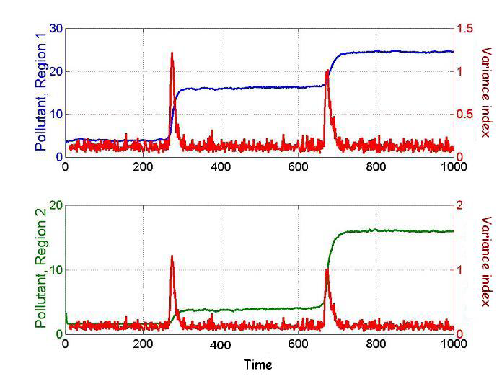
Ahora vamos a utilizar la espacialidad explícita de los autómatas celulares para obtener señales de alerta temprana , principalmente espaciales.
Two types of early warnings:
SPATIAL → vegetation patterns
(desertification)
TEMPORAL E. W. →Mean Field models → temporal variance
Copyright © 2006 by the author(s). Published here under license by the Resilience Alliance. Brock, W. A., and S. R. Carpenter. 2006. Variance as a leading indicator of regime shift in ecosystem services. Ecology and Society 11(2): 9

Slide 7
SPATIAL MODELS: CELLULAR AUTOMATA
We are interested in both temporal & spatial signals, of a dynamical model with production and consumption (x & y are the spatial coordinates)
Indeed we work on a spatial square lattice:
site (i,j)
i.e., we have a cellular automaton.
one constant and spatially heterogeneous K=K_{ij}
Therefore, 2 parameters: one variable and spatially homogeneous c(t)
(+ the diffusion coefficient D )

Slide 8
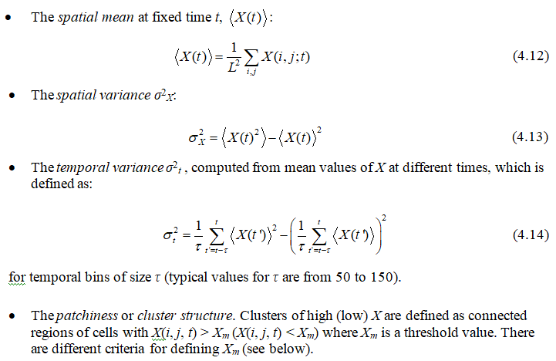

Some indicators which can be computed:

Slide 9
In Fig. 4.7 we plot ⟨X⟩, σ²_{X} and σ²_{t} in terms of an increasing c for a fixed average capacity ⟨K⟩ = 7.5, d = 0.1 and the initial condition for each X(i, j) in the interval [0, ⟨K⟩].
Notice that the spatial variance has a peak at c_{m} ≅ 2.08. This peak occurs nearly 110 time steps earlier than the peak for the temporal variance.
Figure 4.7. <X>, σ²_{X} and σ²_{t} for d = 0.1, <K> = 7.5. The peak of σ²_{X} occurs at c_{m} ≅ 2.08 and the peak of σ²_{t} at c ≅ 2.30.
So σ²_{X} works better than σ²_{t} as a warning signal for the upcoming catastrophic shift.
This is because when estimating the temporal variance one must consider past values in the time series, which correspond to situations where the ecosystem is far from undergoing a transition.
The spatial variance instead only considers the present values; hence a signal announcing the shift is not blurred by averages including situations where these indications are smaller, or even absent.
It is interesting to look at the process inverse to desertification or vegetation restoration. For this we need to analyze what happens when c is decreased.
Fig. 4.8 shows the hysteresis cycles, for the mean vegetation (black curves) when we first increase c so that desertification takes place and the reverse the trend and decrease c, for different values of d.

Slide 10
Figure 4.8. <X> (black curves) and σ²_{X} (blue curves) for <K> = 7.5 and δK = 2.5, computed for forward and backward changes of the control parameter c. Results for d = 0 (above), d = 0.1 (middle) and d = 0.5 (below).
Notice two remarkable things.
First, the peak in σ²_{X} is always narrower for the backward transition than for the forward transition.
Second, the width of the hysteresis loop decreases with d, so diffusion tends to make the shift steeper.

Slide 11
Patchiness (Distribution of Clusters)
To study the cluster structure first we have to define a threshold X_{m} which separates low from high density vegetation cells.
For <K> = 7.5 and d = 0.1 the maximum in σ²_{X} is given at c_{m} ≅ 2.08.
One possible choice is to take X_{m} coinciding with the average value of X(i,j) at c = c_{m}, i.e.
X_{m} = ⟨X⟩(c_{m}) ≅ 2.89. This is the threshold we will take.

Slide 12
We found for a grazing model:
Figure 4.10. First column: a portion of 50 × 50 cells from the original 800 × 800 lattice is shown, grids representing the value taken by X(i, j) at each cell for ⟨K⟩ = 7.5, d = 0.1. The rows correspond to c = 1.98, c = 2.08 and c = 2.18. Second column: same as the first, for binarized data (blue: cells with low vegetation density, red: cells with high vegetation density). Third column: number of clusters versus area on a logarithmic scale.

Slide 13
In the first column of Fig. 4.10 we include snapshots of typical patch configurations for c = c_{m} − 0.1, c = c_{m} and c = c_{m} + 0.1.
Densely vegetated patches correspond to clusters of cells which are all between yellow and red.
Conversely, bare patches appear in blue.
The second column a binary representation, i.e., dark red (blue) cells correspond to cells for which X > ⟨X⟩ c_{m} (X < ⟨X⟩ c_{m}).
The plots in the third column are the corresponding cluster distributions. At c = cm the patch-size distribution follows a power law over two decades —with exponent γ ≈ −1.1 for d = 0.1 and γ ≈ −0.9 for d = 0.5— which disappears for smaller or greater value of c.
Therefore, the power law distribution may be considered as a signature of an ongoing desertification.

Slide 14
Correlation: Two point correlation function
C₂(d ) = ⟨x(i₁, j₁)x(i₂, j₂)⟩ -⟨x(i₁, j₁)⟩ ⟨x(i₂, j₂)⟩
It is easy to check that the spatial variance is a particular case (distance R = 0) of the two-point correlation function defined by
The two-point correlation is depicted for distances R = 0, 1, 2, 3. Notice that the peak of the correlation for any R occurs at nearly the same value of the control parameter c ≈ c_{m} = 2.08.

