Slide 1
Territorios cromosómicos.

Slide 2
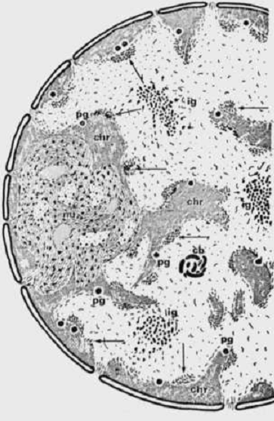
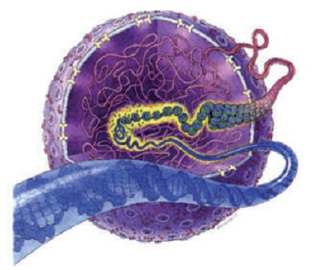
Microscopía electrónica de transmisión
del núcleo celular (corte ultrafino) en los 50.
Esquema de organización
nuclear (década del 90')

Slide 3

“During the 1970s and 80ies most researchers seemed to be content with the assumption that the nucleus is filled with intermingling chromatin fibers and loops like a dish of spaghetti, an assumption widely reflected by textbooks of cell biology”.
Extraído de Cremer y Cremer (Cold Spring Harb Perspect Biol 2010; doi: 10.1101/cshperspect.a003889)

Slide 4
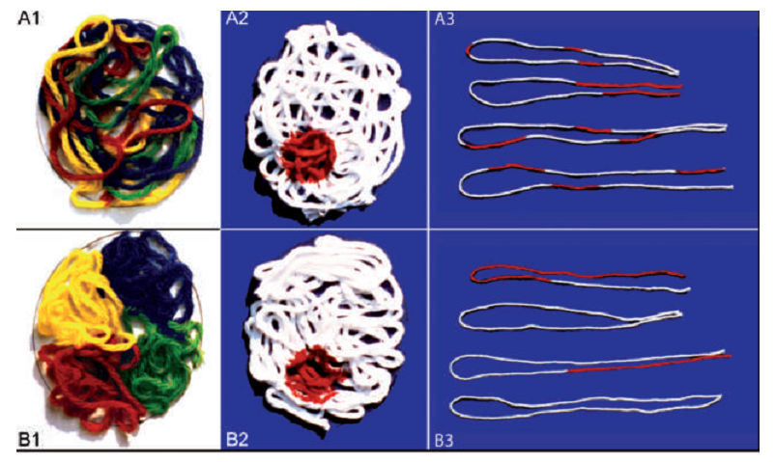
Experimentos de microirradiación de núcleos
(Cremer, 1983)
Extraído de Cremer y Cremer 2010

Slide 5
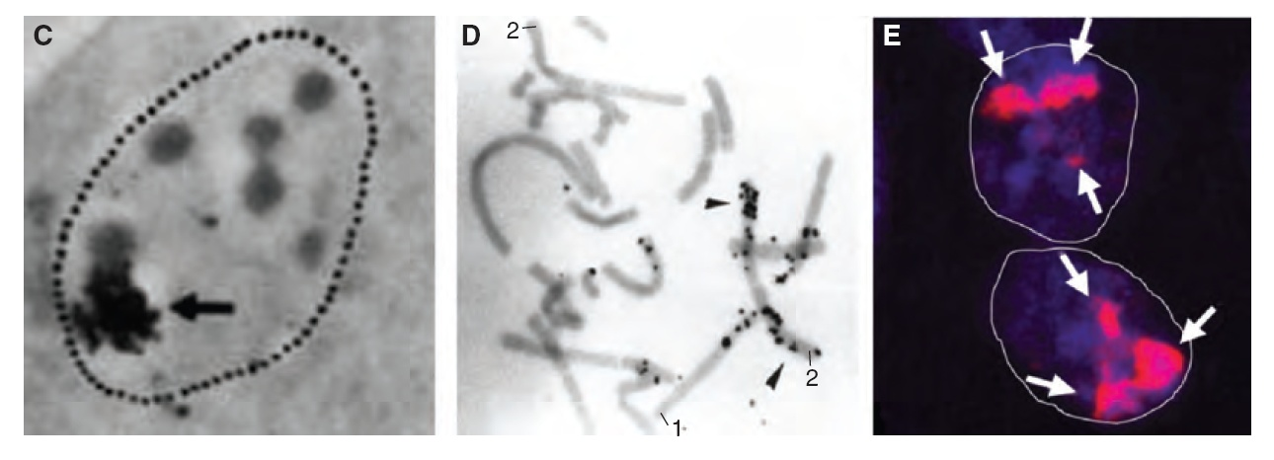
Experimentos de microirradiación de núcleos
(Cremer, 1983)
Primeras evidencias experimentales de la existencia
de territorios cromosómicos en el nucleo interfasico

Slide 6
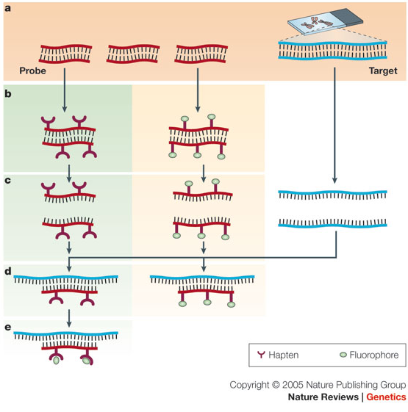
Hibridización in situ fluorescente
(Fluorescence in situ hybridization, FISH)
Speicher & Carter (2005) Nature Rev Genet 6:782]

Slide 7
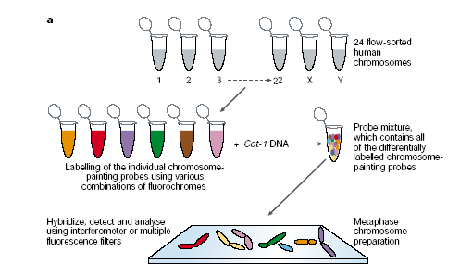
Pintura de cromosomas específicos (Chromosome-specific paints) for FISH

Slide 8
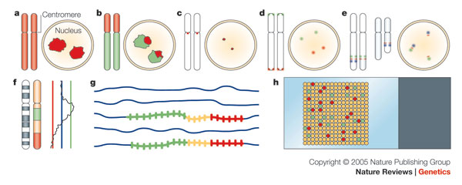
Pintura de cromosomas específicos (Chromosome-specific paints) for FISH
Microscopia de Barrido Laser Confocal y tratamiento de imágenes
logran una visión y localización tridimensional de alta precisión
Speicher & Carter (2005) Nature Rev Genet 6:782

Slide 9
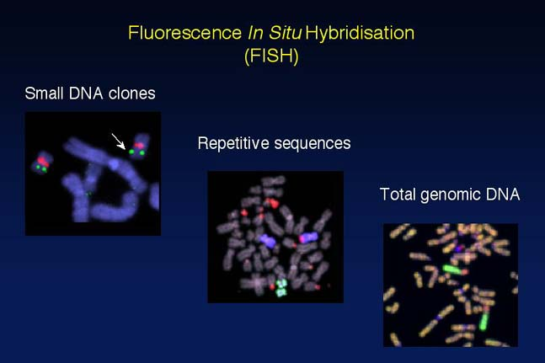

Slide 10
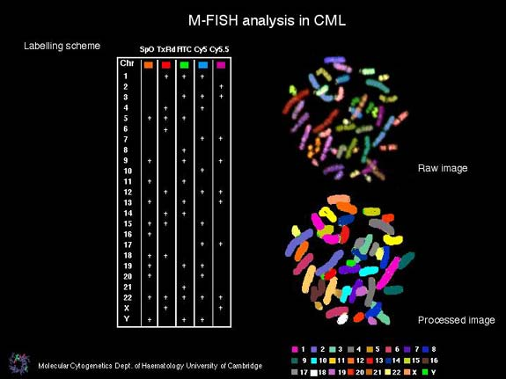
(FISH) – Metaphase chromosome painting

Slide 11
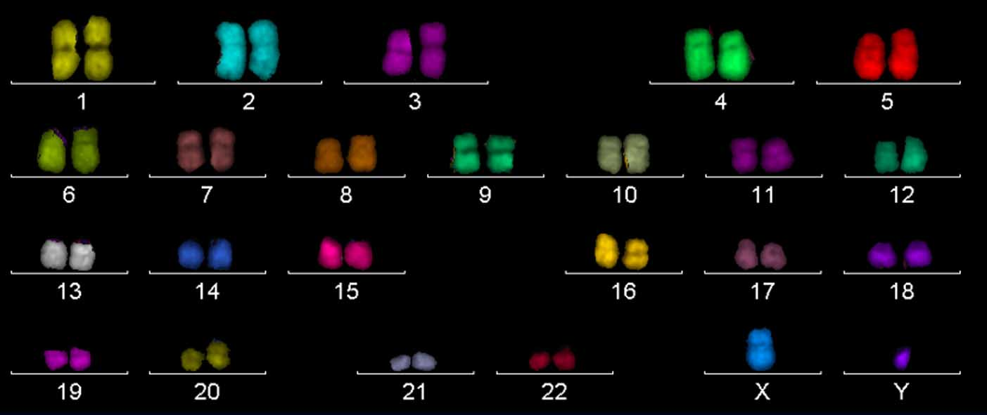
Cromosomas humanos: FISH multicolor

Slide 12
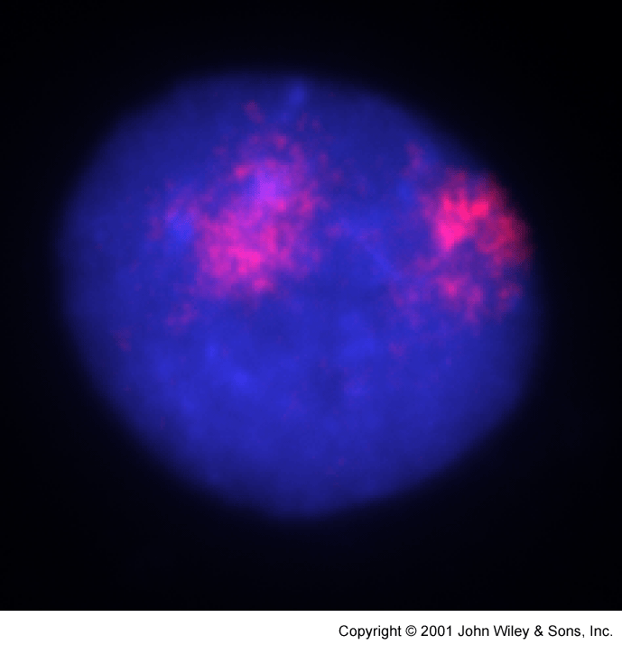
Territorios Cromosómicos (TCs)
La técnica de FISH utilizando sondas para detectar todo el cromosoma (WCP) revelaron que el núcleo eucariótico posee un elevado nivel de organización. El volumen nuclear se halla compartimentado en territorios cromosómicos (TCs) tridimensionales discretos y no superpuestos.
10μm

Slide 13
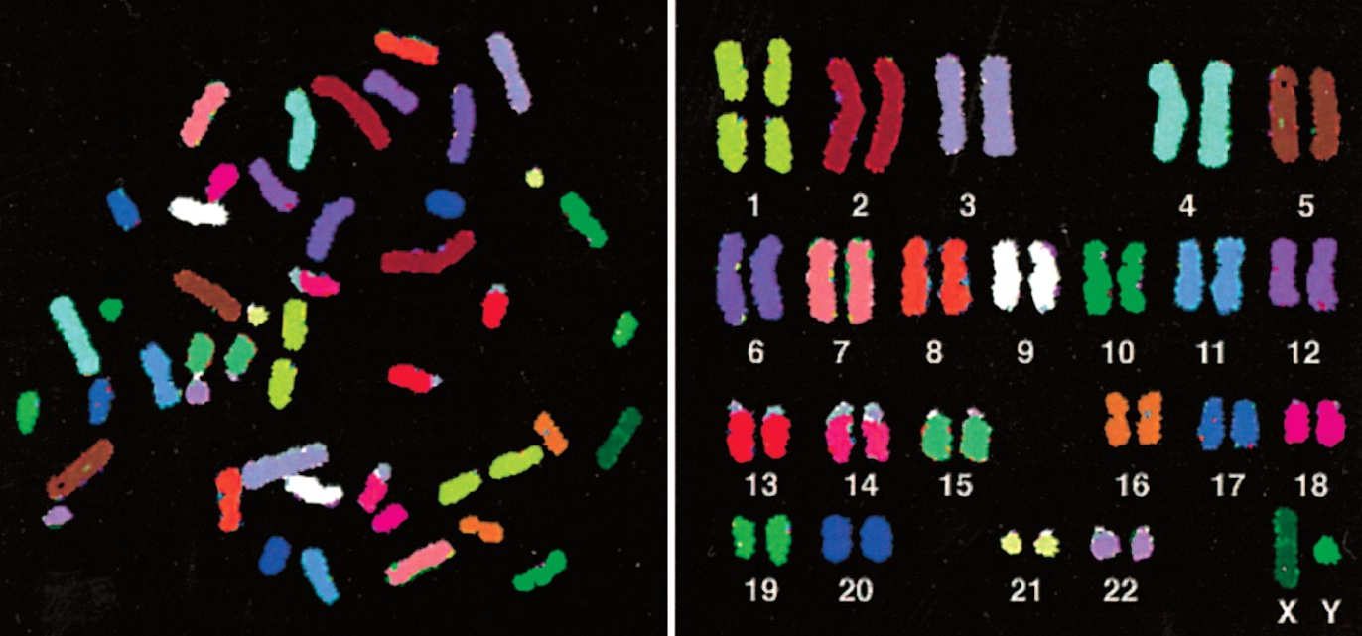
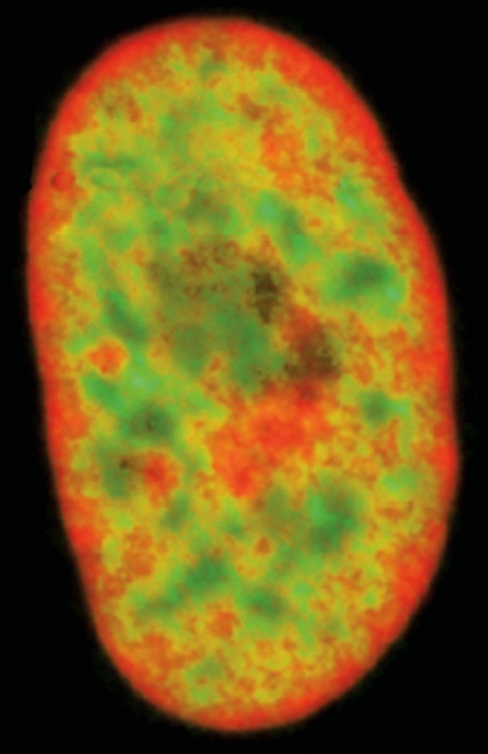
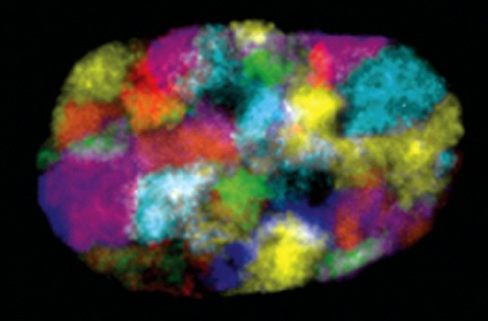

Organización del núcleo
“Chromosome painting”
Muchos genes
Algunos genes
Pocos genes
Notes:
Figure 4-10 The complete set of human
chromosomesT. hesec hromosomesf,r om
a male,w erei solatedfr om a cell
undergoingn ucleadr ivision( mitosisa) nd
aret hereforeh ighlyc ompactedE. ach
chromosomeh asb een" painteda"
differenct olort o permiti tsu nambiguous
identificatiounn dert he lightm icroscope.
Chromosomep aintingi s performedb y
exposingth e chromosometso a collection
of humanD NAm oleculetsh at haveb een
coupledt o a combinationo f fluorescent
dyes.F ore xampleD, NAm oleculeds erived
from chromosome1 arel abeledw ith one
specificd ye combination,t hosef rom
chromosome2 with anothera, nd so on.
Becausteh e labeledD NAc anf orm base
pairso, r hybridizeo,n lyt o the
chromosomef rom which it was derived
(discusseidn Chapter8 ),e ach
chromosomeis d ifferentlyla beledF. or
suche xperimentsth, e chromosomeasr e
subjectedt o treatmentst hat separateth e
double-helicaDl NAi nto individuasl trands,
designedto permitb ase-pairinwgi th the
single-strandeladb eledD NAw hile
keepingt he chromosomes tructure
relativelyin tact.( A)T hec hromosomes
visualizeads t heyo riginallys pilledfr om
the lysed cell. (B) The same chromosomes
artificialllyin edu p in theirn umericaol rder.
Thisa rrangemenot f the full chromosome
seti sc alleda karyotype(.F romE .S chrock
et al..S cience2 73:494-497,1996W. ith
permissionfr om AAAS.)
Figure4 -63 Simultaneouvsi sualizationo f the chromosomete rritories
for all of the humanc hromosomesin a singlei nterphasen ucleusA. FISH
analysius singa differenmt ixtureo f fluorochromefso r markingt he DNAo f
eachc hromosomed,e tectedw ith sevenc olorc hannelsin a fluoresence
microscopea,l lowse achc hromosometo be distinguisheidn threedimensionarle
constructionBse. lowt he micrographe,a chc hromosomeis
identifiedin a schematioc f the actuali mage.N otet hat the two
homologousc hromosome(se .g.t,h e two copieso f chromosome9 ),a ren ot
in generacl o-located(.F romM .RS. peichear nd N.PC. arterN, at'R evG. enet.
6:782-792,200W5.i thp ermissiofnr om MacmillanP ublisherLst d.)
Figure4 -64T hed istributioonf gene-ricrhe gionos f theh umang enome
in ani nterphasneu cleusG. ene-ricrhe gionhsa veb eenv isualizewdit ha
fluorescepnrto beth ath ybridizetos t heA lui nterspersreedp eawt, hichis
presenint moret hana millionc opieisn t heh umang enome(s eeF igure
5-75)F. oru nknownre asontsh,e ses equenceclsu steirn c hromosomal
regionrsic hi ng enesI.n t hisr epresentatiroeng, ionesn richefdo rt heA lu
sequencaet eg reenr,e gionds epletedfo rt heses equenceasre r edw, hile
thea veragree gionas rey el/or,Tvh. eg ene-ricrhe gionas res eento be
depletedin the DNAn eart he nucleaer nvelope(F. romA .B olzeer t al.,p LoS
Biol.3:826-84220,0 5W. ithp ermissiofnro mp ublicL ibrarvo f Science.)

Slide 14
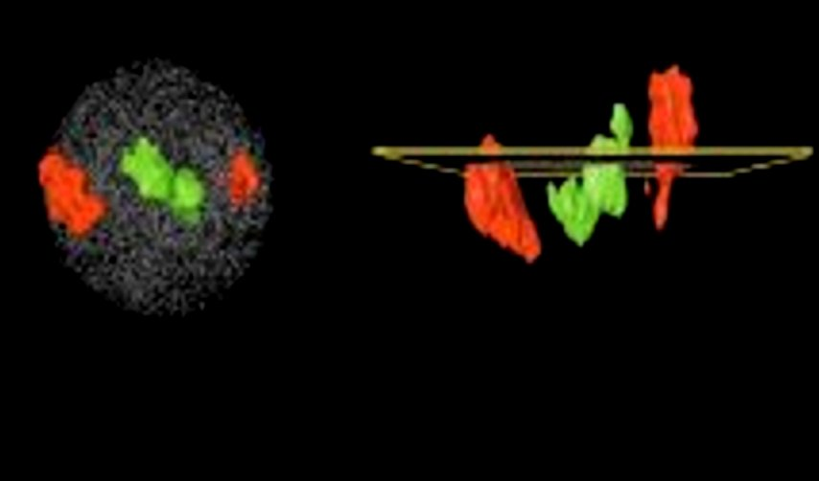
Topología nuclear de cromosomas ricos (19) y pobres (18) en genes
19
19
18
18
18
18
19
19
Y
Z
5 μm
X
X
Cremer and Cremer (2001) Nat Rev Genet 2: 292-301

Slide 15
Territorios cromosómicos y evolución
Tanabe et al. (2002) PNAS 99 (7): 4424-4429

Slide 16
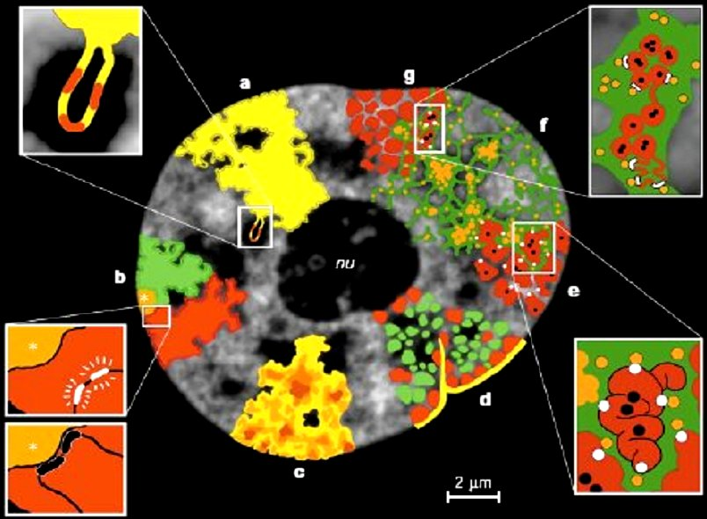
Modelo TC/IC
CI + CN
Loop de cromatina activa en el IC
p
Genes inactivos
TCs de brazos
Genes activos
q
h
h
Genes ↓
Efecto de posición
Genes ↑
Cremer y Cremer (2001) Nat Rev Genet 2: 292-301 (modificado)
Notes:
Model of functional nuclear architecture. Structural features that support the
chromosome-territory–interchromatin-compartment (CT–IC) model are shown. These features
are drawn roughly to scale on an optical section taken from the nucleus of a living HeLa cell.
Although experimental evidence is available to support these features, the overall model of
functional nuclear architecture is speculative (see text). a | CTs have complex folded surfaces.
Inset: topological model of gene regulation23. A giant chromatin loop with several active genes
(red) expands from the CT surface into the IC space. b | CTs contain separate arm domains for
the short (p) and long chromosome arms (q), and a centromeric domain (asterisks). Inset:
topological model of gene regulation78,79. Top, actively transcribed genes (white) are located on
a chromatin loop that is remote from centromeric heterochromatin. Bottom, recruitment of the
same genes (black) to the centromeric heterochromatin leads to their silencing. c | CTs have
variable chromatin density (dark brown, high density; light yellow, low density). Loose chromatin
expands into the IC, whereas the most dense chromatin is remote from the IC. d | CT showing
early-replicating chromatin domains (green) and mid-to-late-replicating chromatin domains (red).
Each domain comprises ~1 Mb. Gene-poor chromatin (red), is preferentially located at the
nuclear periphery and in close contact with the nuclear lamina (yellow), as well as with infoldings
of the lamina and around the nucleolus (nu). Gene-rich chromatin (green) is located between the
gene-poor compartments. e | Higher-order chromatin structures built up from a hierarchy of
chromatin fibres88. Inset: this topological view of gene regulation27,68 indicates that active genes
(white dots) are at the surface of convoluted chromatin fibres. Silenced genes (black dots) may
be located towards the interior of the chromatin structure. f | The CT–IC model predicts that the
IC (green) contains complexes (orange dots) and larger non-chromatin domains (aggregations
of orange dots) for transcription, splicing, DNA replication and repair. g | CT with ~1-Mb
chromatin domains (red) and IC (green) expanding between these domains. Inset: the
topological relationships between the IC, and active and inactive genes72. The finest branches
of the IC end between ~100-kb chromatin domains. Top: active genes (white dots) are located
at the surface of these domains, whereas silenced genes (black dots) are located in the interior.
Bottom: alternatively, closed ~100-kb chromatin domains with silenced genes are transformed
into an open configuration before transcriptional activation.
© 2001 Macmillan Magazines Ltd

Slide 17
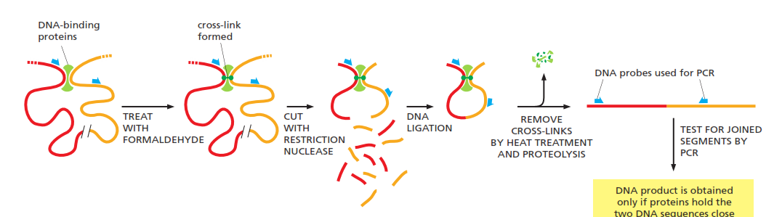
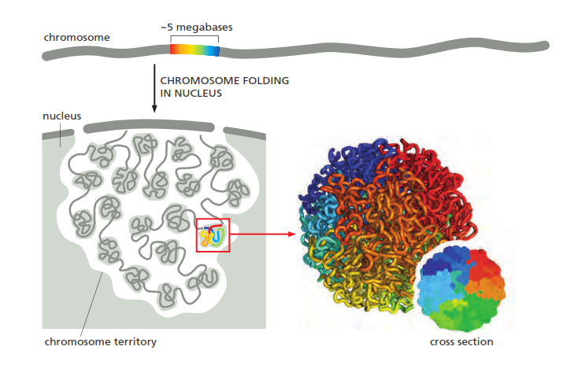
Captura de la conformación de la cromatina: secuenciando para comprender estructura

Slide 18
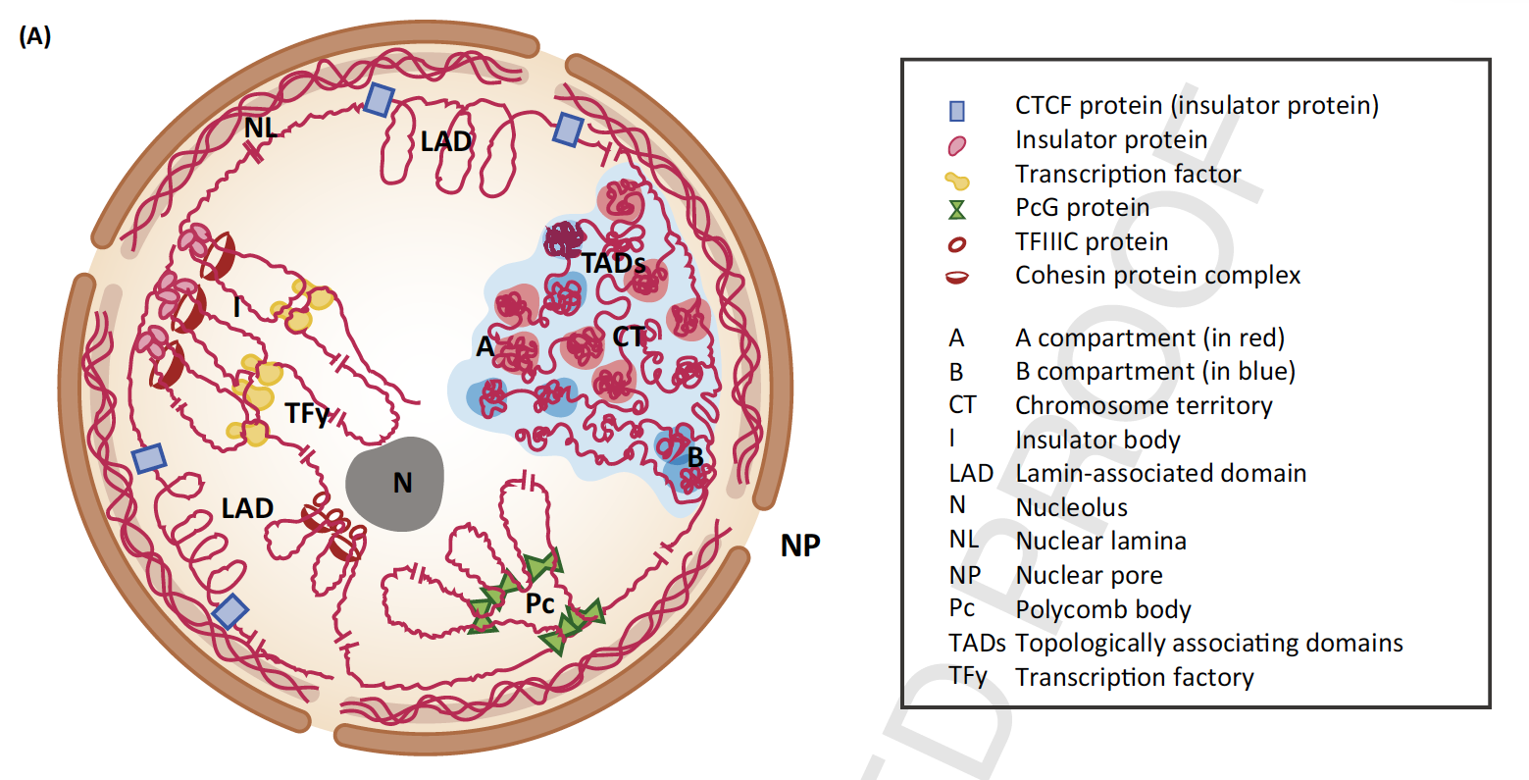
Sotelo Silveira M et al 2018

Slide 19
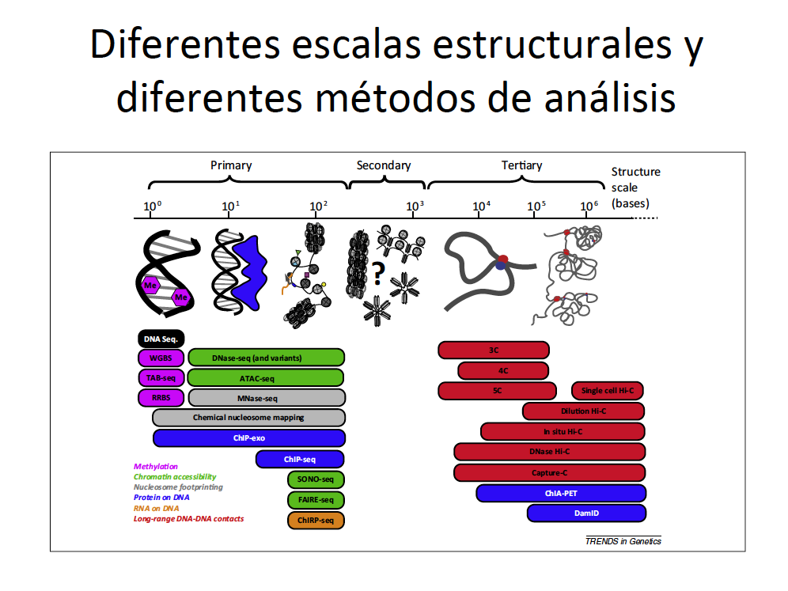

Slide 20
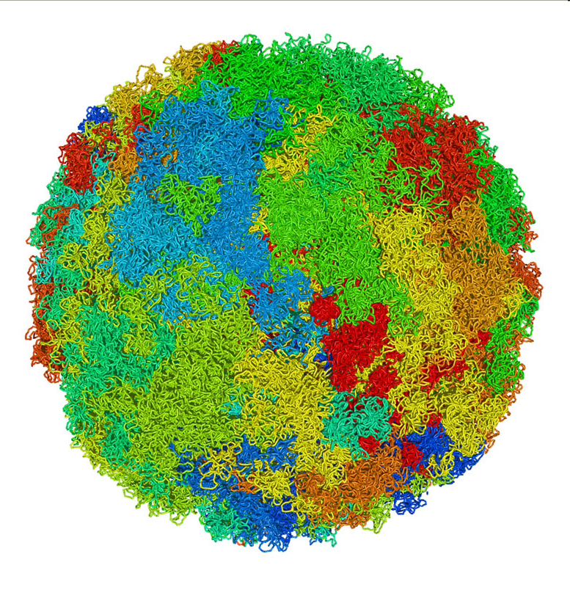

Slide 21
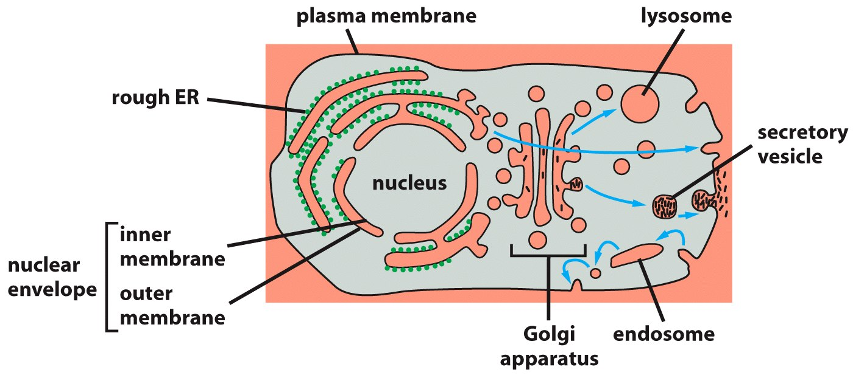
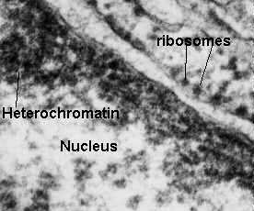
Relaciones entre los compartimientos celulares
NUCLEOPLASMA
CITOSOL
ESPACIO
PERINUCLEAR
LUZ DEL RETÍCULO
ENDOPLÁSMICO
Notes:
Figure 12–5 Topological relationships
between compartments of the
secretory and endocytic pathways in a
eucaryotic cell. Topologically equivalent
spaces are shown in red. In principle,
cycles of membrane budding and fusion
permit the lumen of any of these
organelles to communicate with any
other and with the cell exterior by
means of transport vesicles. Blue arrows
indicate the extensive outbound and
inbound vesicular traffic (discussed in
Chapter 13). Some organelles, most
notably mitochondria and (in plant
cells) plastids, do not take part in this
communication and are isolated
from the traffic between organelles
shown here.

Slide 22
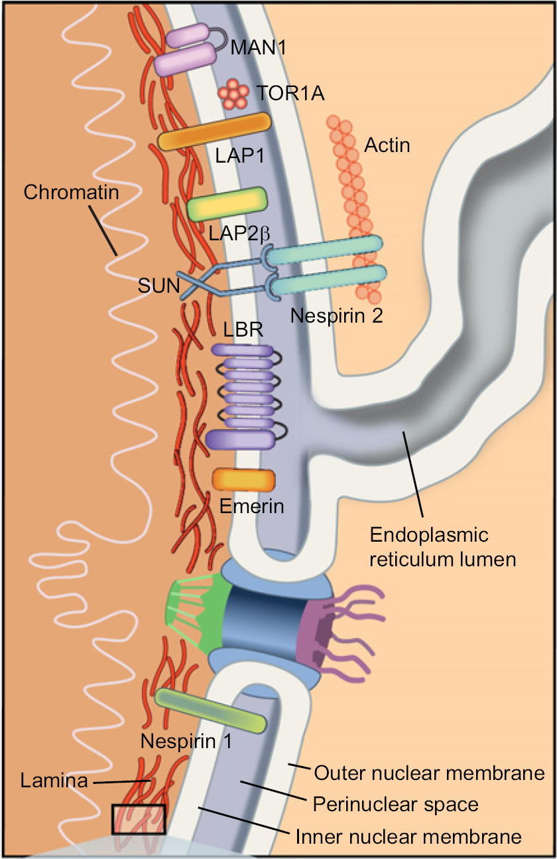
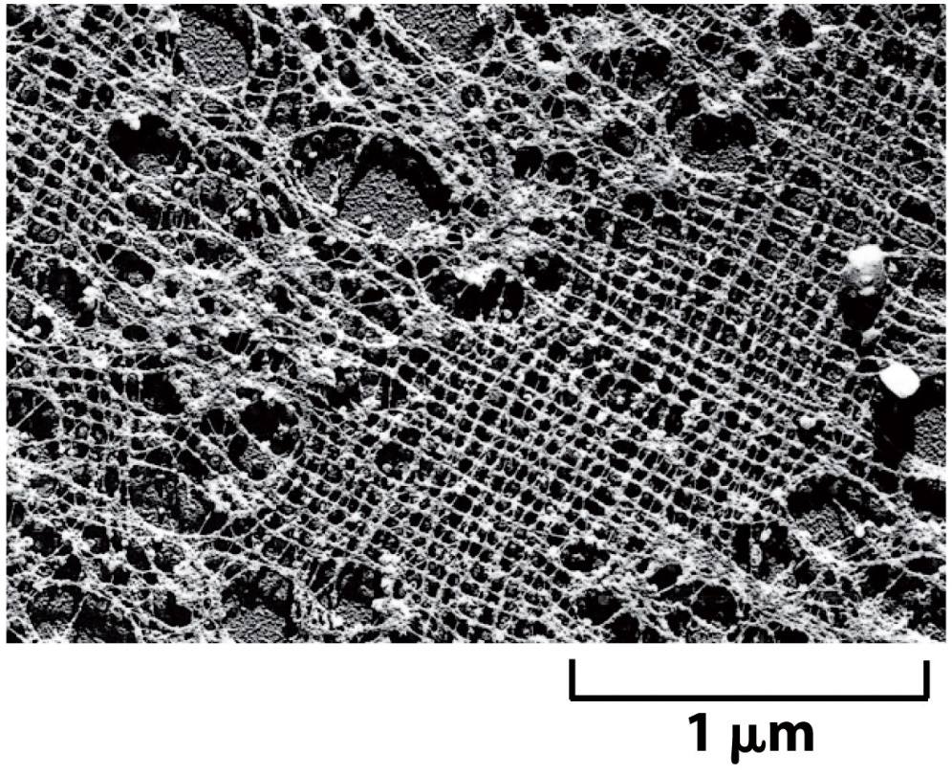
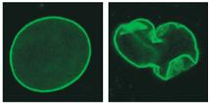
Envoltura y lámina nuclear
Laminas
Normal
Progeria

Slide 23
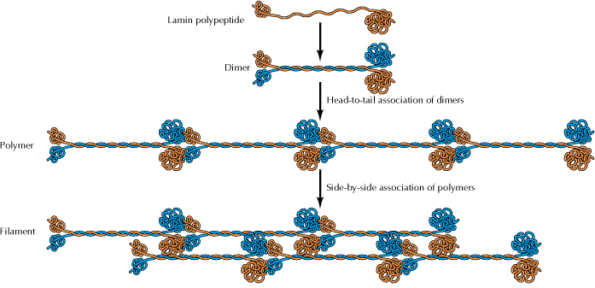
Lámina nuclear y “laminas”
Laminas A: A y C
Laminas B: B1 y B2
Notes:
Las Laminas están alteradas en estas patologías. También aparecen atípicas otras proteínas de la envoltura nuclear

Slide 24
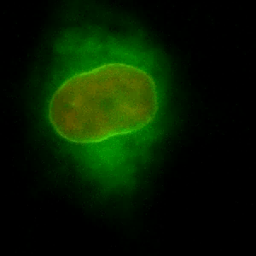

Slide 25
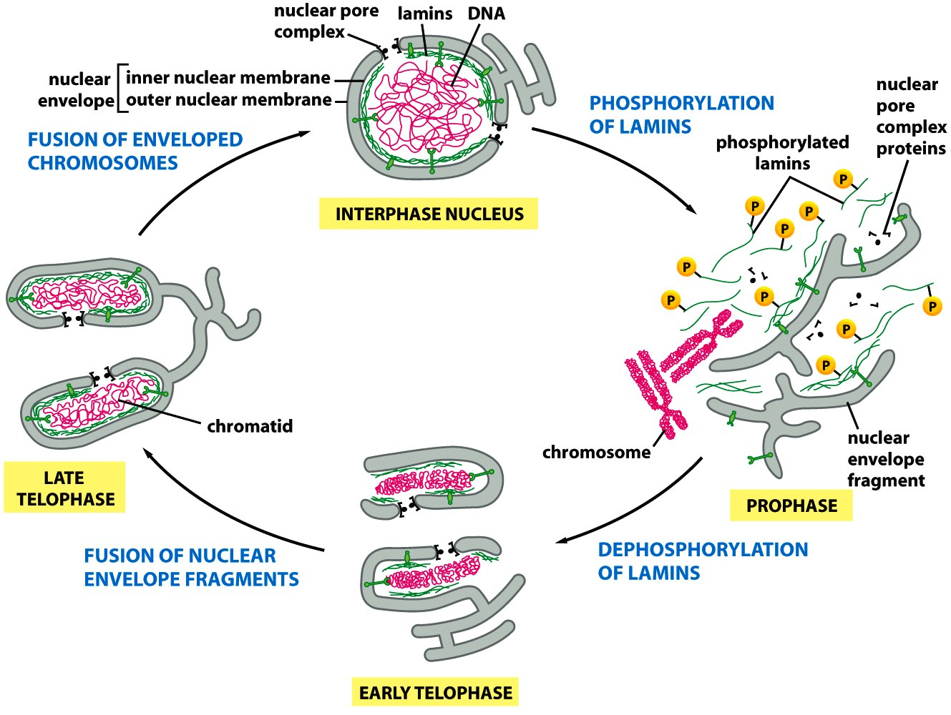
Envoltura y lámina nuclear en el ciclo celular

Slide 27
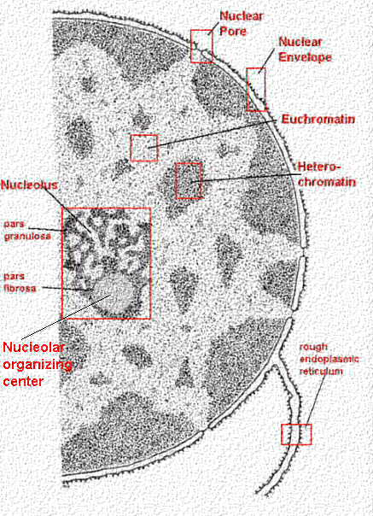
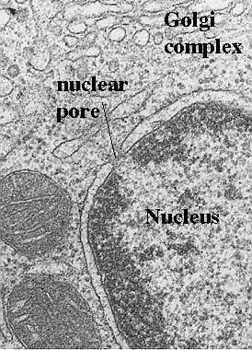
Envoltura nuclear

Slide 28
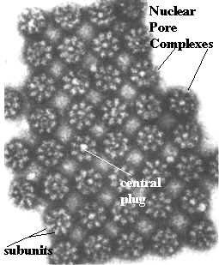
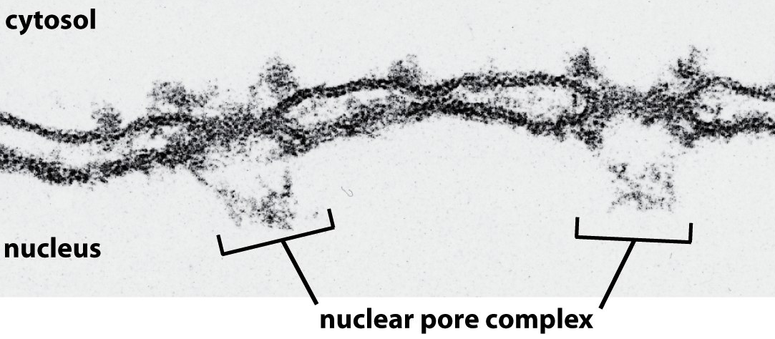
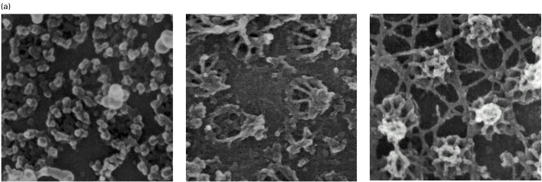
Conexión entre el citosol y el nucleoplasma:
El poro nuclear
Notes:
Imágenes: MET con tinción negativa
Figure 12–9 The arrangement of NPCs in the nuclear envelope. (A) A small region of the nuclear envelope. In cross section, an NPC seems to
have four structural building blocks: column subunits, which form the bulk of the pore wall; annular subunits, which are centrally located;
lumenal subunits, which contain transmembrane proteins that anchor the complex to the nuclear membrane; and ring subunits, which form
the cytosolic and nuclear faces of the complex. In addition, fibrils protrude from both the cytosolic and the nuclear sides of the NPC. On the
nuclear side, the fibrils converge to form basketlike structures. Immunoelectron microscopic studies show that the proteins that make up the
core of the NPC are oriented symmetrically across the nuclear envelope, so that the nuclear and cytosolic sides of the core look identical. In
contrast, the proteins that make up the fibrils are different on the cytosolic and nuclear sides of the NPC. The eight-fold rotational and two-fold
transverse symmetry of the core NPC explains how such a huge structure can be formed from only about 30 different proteins: many of these
proteins are present in 16 copies (or multiples of 16). Disordered domains of the core proteins (not shown) are thought to extend toward the
center of the NPC, blocking the passive diffusion of large macromolecules. (B) A scanning electron micrograph of the nuclear side of the
nuclear envelope of an oocyte (see also Figure 9–55). (C) An electron micrograph showing a side view of two NPCs (brackets); note that the
inner and outer nuclear membranes are continuous at the edges of the pore. (D) An electron micrograph showing face-on views of negatively
stained NPCs. The membrane has been removed by detergent extraction. Note that some of the NPCs contain material in their center, which is
thought to be macromolecules in transit through these NPCs. (B, from M.W. Goldberg and T.D. Allen, J. Cell Biol. 119:1429–1440, 1992. With
permission from The Rockefeller University Press; C, courtesy of Werner Franke and Ulrich Scheer; D, courtesy of Ron Milligan.)

Slide 29
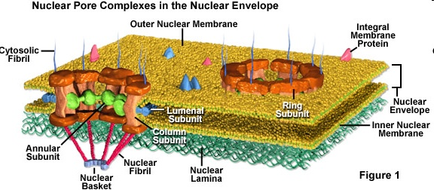
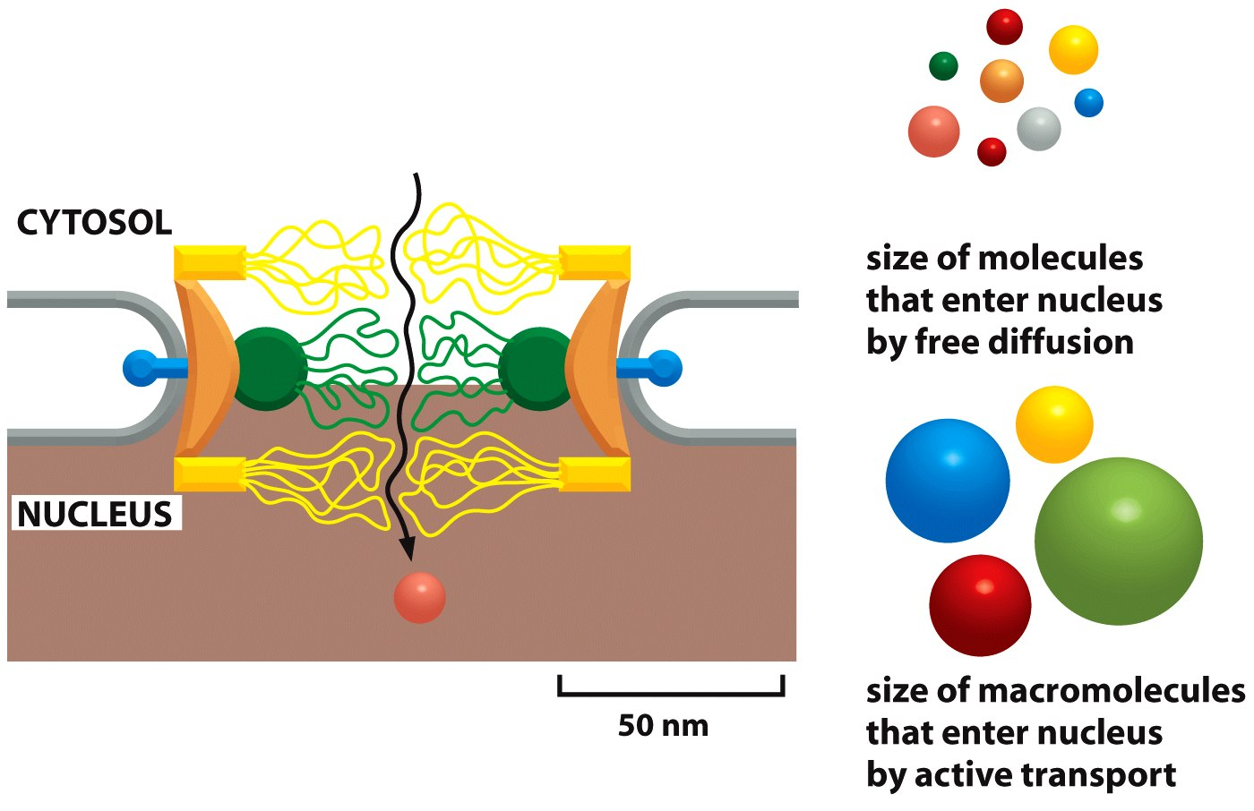
Estructura del poro nuclear
Notes:
Figure 12–9 The arrangement of NPCs in the nuclear envelope. (A) A small region of the nuclear envelope. In cross section, an NPC seems to
have four structural building blocks: column subunits, which form the bulk of the pore wall; annular subunits, which are centrally located;
lumenal subunits, which contain transmembrane proteins that anchor the complex to the nuclear membrane; and ring subunits, which form
the cytosolic and nuclear faces of the complex. In addition, fibrils protrude from both the cytosolic and the nuclear sides of the NPC. On the
nuclear side, the fibrils converge to form basketlike structures. Immunoelectron microscopic studies show that the proteins that make up the
core of the NPC are oriented symmetrically across the nuclear envelope, so that the nuclear and cytosolic sides of the core look identical. In
contrast, the proteins that make up the fibrils are different on the cytosolic and nuclear sides of the NPC. The eight-fold rotational and two-fold
transverse symmetry of the core NPC explains how such a huge structure can be formed from only about 30 different proteins: many of these
proteins are present in 16 copies (or multiples of 16). Disordered domains of the core proteins (not shown) are thought to extend toward the
center of the NPC, blocking the passive diffusion of large macromolecules. (B) A scanning electron micrograph of the nuclear side of the
nuclear envelope of an oocyte (see also Figure 9–55). (C) An electron micrograph showing a side view of two NPCs (brackets); note that the
inner and outer nuclear membranes are continuous at the edges of the pore. (D) An electron micrograph showing face-on views of negatively
stained NPCs. The membrane has been removed by detergent extraction. Note that some of the NPCs contain material in their center, which is
thought to be macromolecules in transit through these NPCs. (B, from M.W. Goldberg and T.D. Allen, J. Cell Biol. 119:1429–1440, 1992. With
permission from The Rockefeller University Press; C, courtesy of Werner Franke and Ulrich Scheer; D, courtesy of Ron Milligan.)
Figure 12–9 The arrangement of NPCs in the nuclear envelope. (A) A small region of the nuclear envelope. In cross section, an NPC seems to
have four structural building blocks: column subunits, which form the bulk of the pore wall; annular subunits, which are centrally located;
lumenal subunits, which contain transmembrane proteins that anchor the complex to the nuclear membrane; and ring subunits, which form
the cytosolic and nuclear faces of the complex. In addition, fibrils protrude from both the cytosolic and the nuclear sides of the NPC. On the
nuclear side, the fibrils converge to form basketlike structures. Immunoelectron microscopic studies show that the proteins that make up the
core of the NPC are oriented symmetrically across the nuclear envelope, so that the nuclear and cytosolic sides of the core look identical. In
contrast, the proteins that make up the fibrils are different on the cytosolic and nuclear sides of the NPC. The eight-fold rotational and two-fold
transverse symmetry of the core NPC explains how such a huge structure can be formed from only about 30 different proteins: many of these
proteins are present in 16 copies (or multiples of 16). Disordered domains of the core proteins (not shown) are thought to extend toward the
center of the NPC, blocking the passive diffusion of large macromolecules. (B) A scanning electron micrograph of the nuclear side of the
nuclear envelope of an oocyte (see also Figure 9–55). (C) An electron micrograph showing a side view of two NPCs (brackets); note that the
inner and outer nuclear membranes are continuous at the edges of the pore. (D) An electron micrograph showing face-on views of negatively
stained NPCs. The membrane has been removed by detergent extraction. Note that some of the NPCs contain material in their center, which is
thought to be macromolecules in transit through these NPCs. (B, from M.W. Goldberg and T.D. Allen, J. Cell Biol. 119:1429–1440, 1992. With
permission from The Rockefeller University Press; C, courtesy of Werner Franke and Ulrich Scheer; D, courtesy of Ron Milligan.)
Figure 12–10 A model for the gated
diffusion barrier of the NPC. The
drawing shows a side view of an NPC.
Unstructured regions of the proteins
lining the central pore form a tangled
meshwork, which blocks the passive
diffusion of large macromolecules.
During active transport, however, even
particles up to 39 nm in diameter can
pass through NPCs.

Slide 30
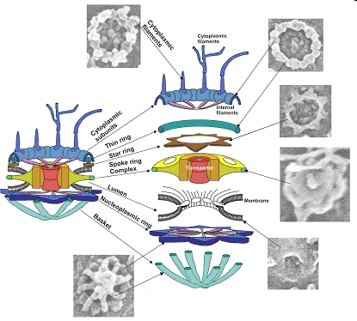
Estructura del
poro nuclear
Microscopía
crio-electrónica
Notes:
Exploded Diagram of the Nuclear Pore Complex.
http://images.google.com.uy/imgres?imgurl=http://www.paterson.man.ac.uk/images/scb1.gif&imgrefurl=http://www.paterson.man.ac.uk/scb/nucpore.stm&usg=__JA_6CK7lxeWVg9UVyqB_3hSeND4=&h=374&w=415&sz=35&hl=es&start=8&um=1&itbs=1&tbnid=l6HlU1Va65PNOM:&tbnh=113&tbnw=125&prev=/images%3Fq%3Dnuclear%2Bpore%2Bcomplex%26um%3D1%26hl%3Des%26safe%3Doff%26client%3Dfirefox-a%26sa%3DX%26rls%3Dorg.mozilla:es-AR:official%26tbs%3Disch:1

Slide 31
Estructura del poro nuclear
Notes:
Figure 12–9 The arrangement of NPCs in the nuclear envelope. (A) A small region of the nuclear envelope. In cross section, an NPC seems to
have four structural building blocks: column subunits, which form the bulk of the pore wall; annular subunits, which are centrally located;
lumenal subunits, which contain transmembrane proteins that anchor the complex to the nuclear membrane; and ring subunits, which form
the cytosolic and nuclear faces of the complex. In addition, fibrils protrude from both the cytosolic and the nuclear sides of the NPC. On the
nuclear side, the fibrils converge to form basketlike structures. Immunoelectron microscopic studies show that the proteins that make up the
core of the NPC are oriented symmetrically across the nuclear envelope, so that the nuclear and cytosolic sides of the core look identical. In
contrast, the proteins that make up the fibrils are different on the cytosolic and nuclear sides of the NPC. The eight-fold rotational and two-fold
transverse symmetry of the core NPC explains how such a huge structure can be formed from only about 30 different proteins: many of these
proteins are present in 16 copies (or multiples of 16). Disordered domains of the core proteins (not shown) are thought to extend toward the
center of the NPC, blocking the passive diffusion of large macromolecules. (B) A scanning electron micrograph of the nuclear side of the
nuclear envelope of an oocyte (see also Figure 9–55). (C) An electron micrograph showing a side view of two NPCs (brackets); note that the
inner and outer nuclear membranes are continuous at the edges of the pore. (D) An electron micrograph showing face-on views of negatively
stained NPCs. The membrane has been removed by detergent extraction. Note that some of the NPCs contain material in their center, which is
thought to be macromolecules in transit through these NPCs. (B, from M.W. Goldberg and T.D. Allen, J. Cell Biol. 119:1429–1440, 1992. With
permission from The Rockefeller University Press; C, courtesy of Werner Franke and Ulrich Scheer; D, courtesy of Ron Milligan.)
Figure 12–9 The arrangement of NPCs in the nuclear envelope. (A) A small region of the nuclear envelope. In cross section, an NPC seems to
have four structural building blocks: column subunits, which form the bulk of the pore wall; annular subunits, which are centrally located;
lumenal subunits, which contain transmembrane proteins that anchor the complex to the nuclear membrane; and ring subunits, which form
the cytosolic and nuclear faces of the complex. In addition, fibrils protrude from both the cytosolic and the nuclear sides of the NPC. On the
nuclear side, the fibrils converge to form basketlike structures. Immunoelectron microscopic studies show that the proteins that make up the
core of the NPC are oriented symmetrically across the nuclear envelope, so that the nuclear and cytosolic sides of the core look identical. In
contrast, the proteins that make up the fibrils are different on the cytosolic and nuclear sides of the NPC. The eight-fold rotational and two-fold
transverse symmetry of the core NPC explains how such a huge structure can be formed from only about 30 different proteins: many of these
proteins are present in 16 copies (or multiples of 16). Disordered domains of the core proteins (not shown) are thought to extend toward the
center of the NPC, blocking the passive diffusion of large macromolecules. (B) A scanning electron micrograph of the nuclear side of the
nuclear envelope of an oocyte (see also Figure 9–55). (C) An electron micrograph showing a side view of two NPCs (brackets); note that the
inner and outer nuclear membranes are continuous at the edges of the pore. (D) An electron micrograph showing face-on views of negatively
stained NPCs. The membrane has been removed by detergent extraction. Note that some of the NPCs contain material in their center, which is
thought to be macromolecules in transit through these NPCs. (B, from M.W. Goldberg and T.D. Allen, J. Cell Biol. 119:1429–1440, 1992. With
permission from The Rockefeller University Press; C, courtesy of Werner Franke and Ulrich Scheer; D, courtesy of Ron Milligan.)
Figure 12–10 A model for the gated
diffusion barrier of the NPC. The
drawing shows a side view of an NPC.
Unstructured regions of the proteins
lining the central pore form a tangled
meshwork, which blocks the passive
diffusion of large macromolecules.
During active transport, however, even
particles up to 39 nm in diameter can
pass through NPCs.

Slide 32
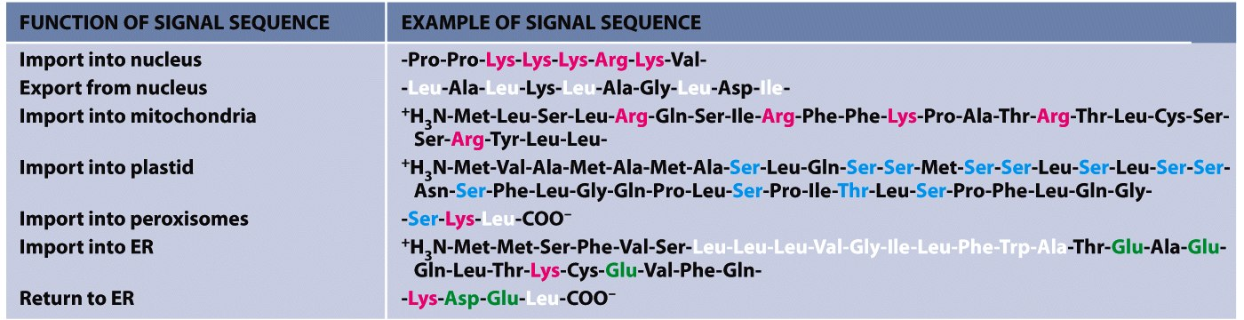
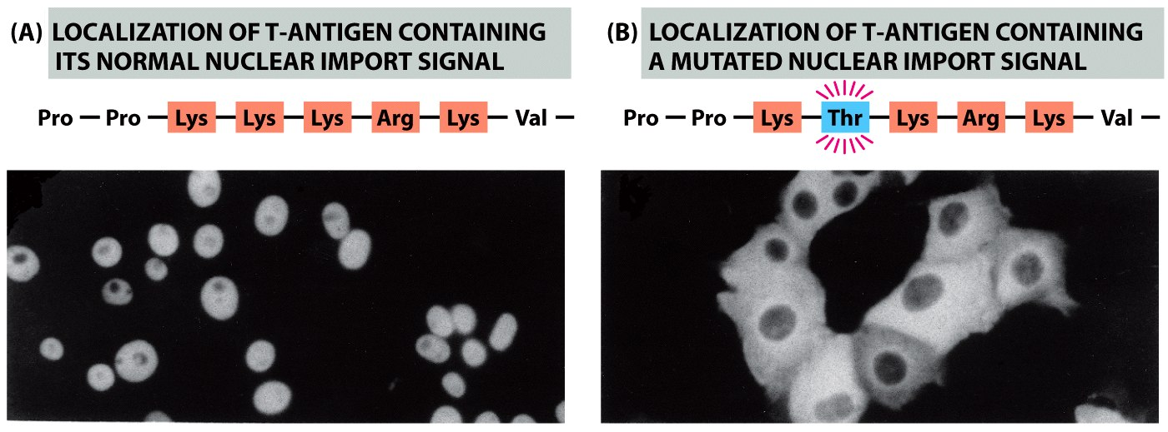
Señales de localizaión de proteínas
FUNCIÓN DE LA SECUENCIA EJEMPLO
Importación nuclear
Exportación nuclear
Importación a mitocondrias
Importación a plástidos
Importación a peroxisomas
Importación a RE
Regreso a RE
Notes:
Some characteristic features of the different classes of signal sequences are highlighted in color. Where they are known to be important for the
function of the signal sequence, positively charged amino acids are shown in red and negatively charged amino acids are shown in green. Similarly,
important hydrophobic amino acids are shown in white and important hydroxylated amino acids are shown in blue. +H3N indicates the N-terminus
of a protein; COO– indicates the C-terminus.
Figure 12–11 The function of a nuclear
localization signal. Immunofluorescence
micrographs showing the cell location of
SV40 virus T-antigen containing or
lacking a short sequence that serves as a
nuclear localization signal. (A) The normal
T-antigen protein contains the lysine-rich
sequence indicated and is imported to its
site of action in the nucleus, as indicated
by immunofluorescence staining with
antibodies against the T-antigen.
(B) T-antigen with an altered nuclear
localization signal (a threonine replacing
a lysine) remains in the cytosol. (From
D. Kalderon, B. Roberts, W. Richardson
and A. Smith, Cell 39:499–509, 1984.
With permission from Elsevier.)

Slide 33
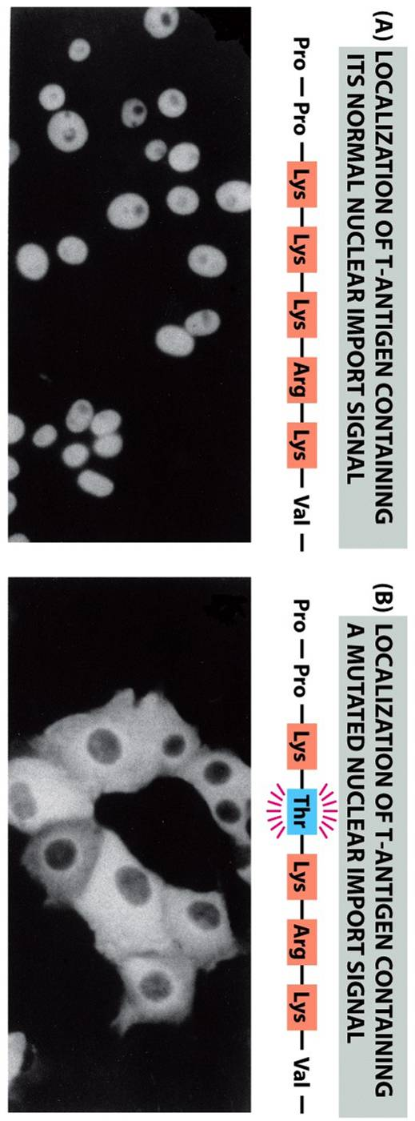
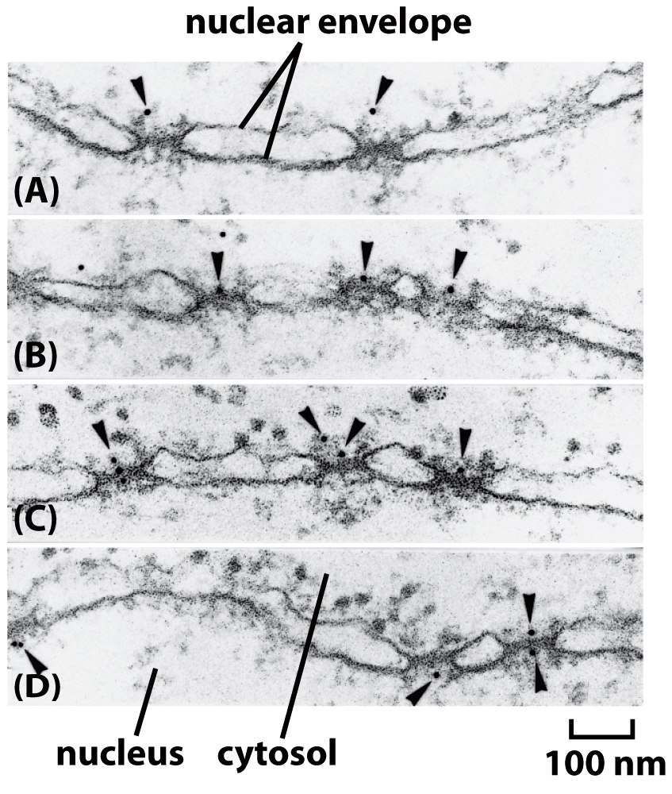
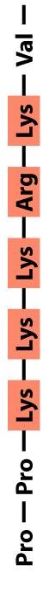
Autonomía de la secuencia de importación nuclear
Partícula de
oro de 5nm
Notes:
Figure 12–12 Visualizing active import
through NPCs. This series of electron
micrographs shows colloidal gold spheres
(arrowheads) coated with peptides
containing nuclear localization signals
entering the nucleus through NPCs. Gold
particles were injected into living cells,
which then were fixed and prepared for
electron microscopy at various times after
injection. (A) Gold particles are first seen
in proximity to the cytosolic fibrils of the
NPCs. (B, C) They migrate to the center of
the NPCs, where they are first seen
exclusively on the cytosolic face. (D) They
then appear on the nuclear face. These
gold particles have much larger diameters
than the diffusion channel in the NPC and
are imported by active transport. (From
N. Panté and U. Aebi, Science
273:1729–1732, 1996. With permission
from AAAS.)

Slide 34
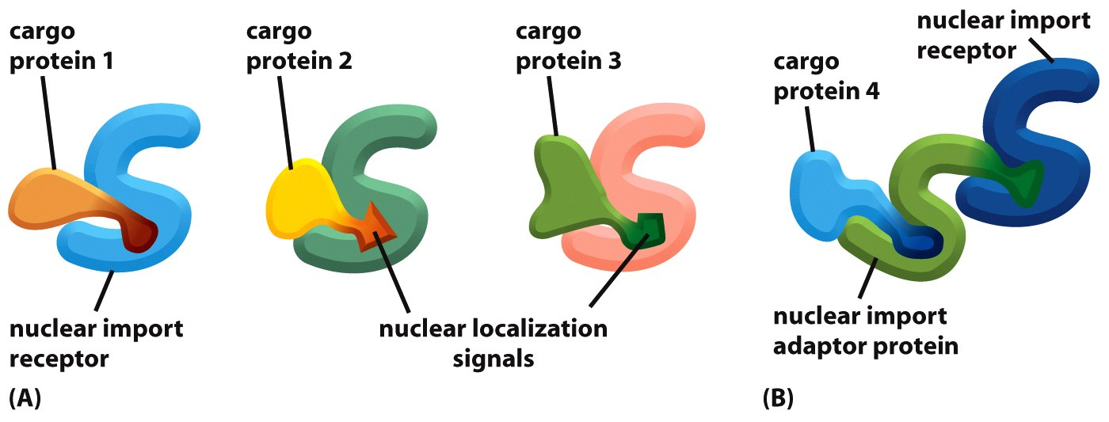
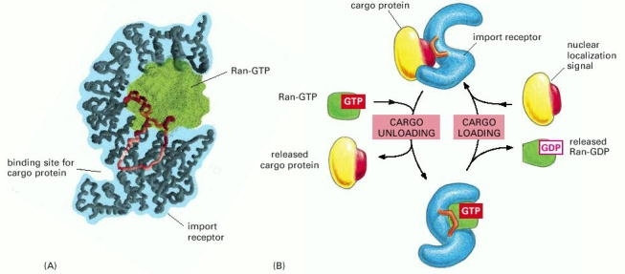
Receptores de importación y exportación nuclear
También llamados: Karioferinas Importinas/exportinas
Notes:
Figure 12–13 Nuclear import receptors.
(A) Many nuclear import receptors bind
both to NPC proteins and to a nuclear
localization signal on the cargo proteins
they transport. Cargo proteins 1, 2, and 3
in this example contain different nuclear
localization signals, and therefore each
binds to different nuclear import
receptors. (B) Cargo protein 4 requires an
adaptor protein to bind to its nuclear
import receptor. The adaptors are
structurally related to nuclear import
receptors and recognize nuclear
localization signals on cargo proteins.
They also contain a nuclear localization
signal that binds them to an import
receptor.
Figure 12–15 A model explaining how
GTP hydrolysis by Ran in the cytosol
provides directionality to nuclear
transport. Movement through the NPC of
loaded nuclear transport receptors
occurs along the FG-repeats displayed by
certain NPC proteins. The differential
localization of Ran-GTP in the nucleus
and Ran-GDP in the cytosol provides
directionality (red arrows) to both nuclear
import (left) and nuclear export (right).
Ran-GAP stimulates the hydrolysis of GTP
to produce Ran-GDP on the cytosolic side
of the NPC (see Figure 12–14).
Ran-GDP is imported into the nucleus
by its own import receptor, which is
specific for the GDP-bound conformation
of Ran. The Ran-GDP receptor is
structurally unrelated to the main family
of nuclear transport receptors. However,
it also binds to FG-repeats in NPC
proteins and hops across the NPC.
Figure 12–16 How the binding of
Ran-GTP can cause nuclear import
receptors to release their cargo. (A) The
structure of a nuclear transport receptor
with bound Ran-GTP. The receptor
contains repeated a-helical motifs that
stack on top of each other, forming a
flexible springlike structure, which can
adopt multiple conformations in
response to the binding of cargo proteins
and Ran-GTP. Note that cargo proteins
and Ran-GTP bind to different regions of
the coiled spring. The Ran-GTP partly
covers a conserved loop (red) of the
receptor, which, in the Ran-free state, is
thought to be important for cargo
binding. (B) The cycle of loading in the
cytosol and unloading in the nucleus of a
nuclear import receptor. (A, adapted from
Y.M. Chook and G. Blobel, Nature
399:230–237, 1999. With permission from
Macmillan Publishers Ltd.)
150 mm
Figure 12–17 The control of nuclear transport in the fly embryo. The
gene regulatory protein dorsal is expressed uniformly throughout this early
Drosophila embryo, which is shown in cross section. The protein has been
stained with an enzyme-coupled antibody that yields a brown product. It is
active only in cells at the ventral side (bottom) of the embryo, where it is
found in nuclei. (Courtesy of Siegfried Roth.)

Slide 35
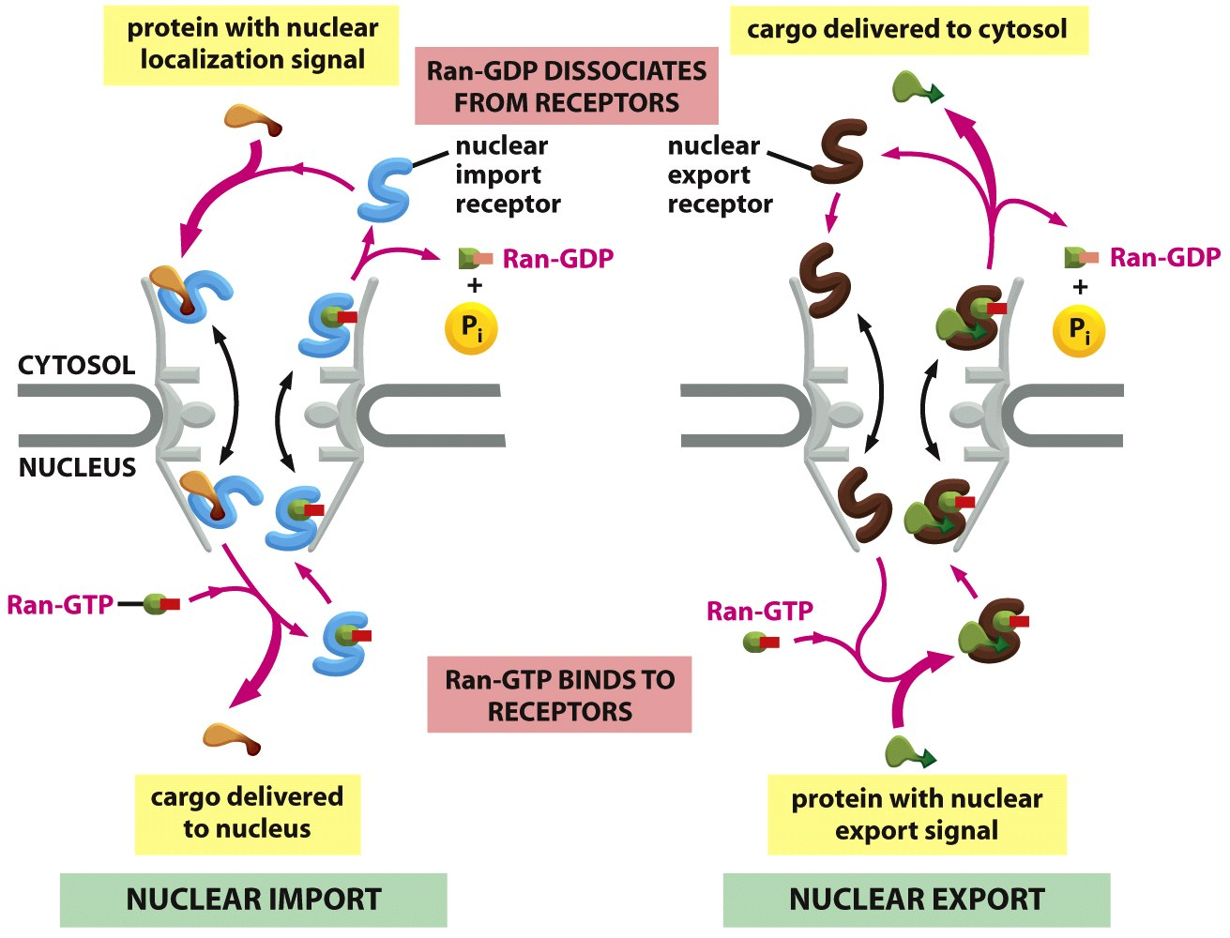
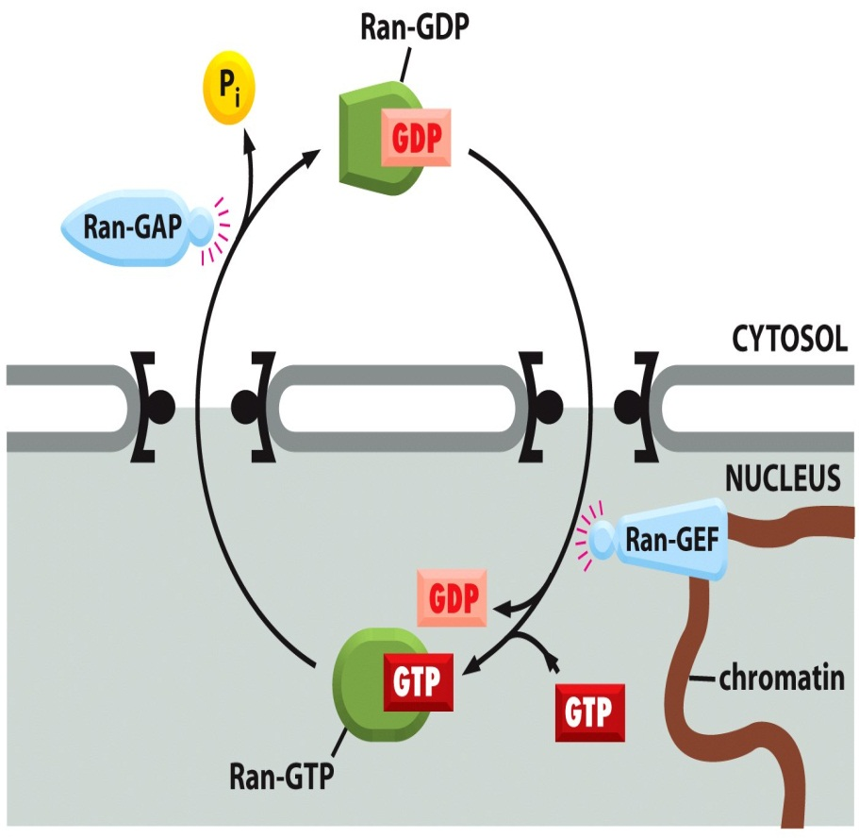
La GTPasa Ran en el
transporte nuclear
Notes:
Figure 12–14 The compartmentalization
of Ran-GDP and Ran-GTP. Localization of
Ran-GDP in the cytosol and Ran-GTP in
the nucleus results from the localization
of two Ran regulatory proteins: Ran
GTPase-activating protein (Ran-GAP) is
located in the cytosol and Ran guanine
nucleotide exchange factor (Ran-GEF)
binds to chromatin and is therefore
located in the nucleus.

Slide 36
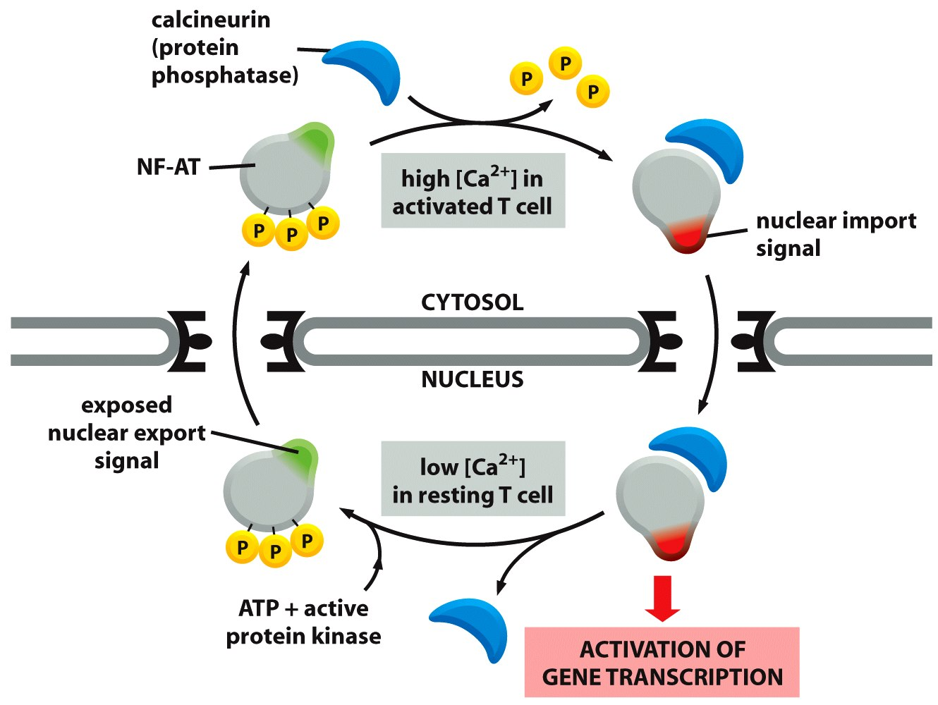
Importación nuclear regulada
Notes:
Figure 12–18 The control of nuclear
import during T cell activation. <AGTT>
The nuclear factor of activated T cells
(NF-AT) is a gene regulatory protein that,
in the resting T cell, is found in the
cytosol in a phosphorylated state. When
T cells are activated by foreign antigen
(discussed in Chapter 25), the
intracellular Ca2+ concentration increases.
In high Ca2+, the protein phosphatase
calcineurin binds to NF-AT and
dephosphorylates it. The
dephosphorylation exposes nuclear
import signals and blocks a nuclear
export signal. The complex of NF-AT and
calcineurin is then imported into the
nucleus, where NF-AT activates the
transcription of numerous genes required
for T cell activation.
The response shuts off when Ca2+ levels
decrease, releasing NF-AT from
calcineurin. Rephosphorylation of NF-AT
inactivates the nuclear import signals
and re-exposes the nuclear export signal,
causing NF-AT to relocate to the cytosol.
Some of the most potent
immunosuppressive drugs, including
cyclosporin A and FK506, inhibit the
ability of calcineurin to dephosphorylate
NF-AT and thereby block the nuclear
accumulation of NF-AT and T cell
activation.

Slide 37
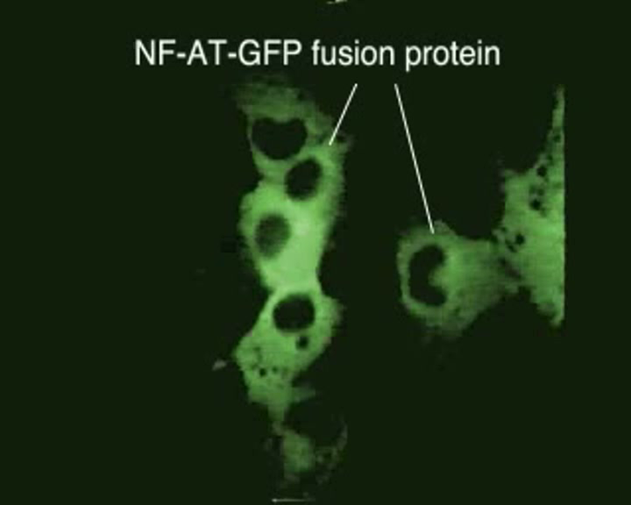

Slide 38
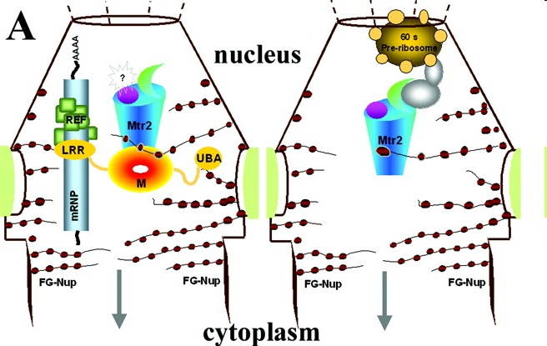
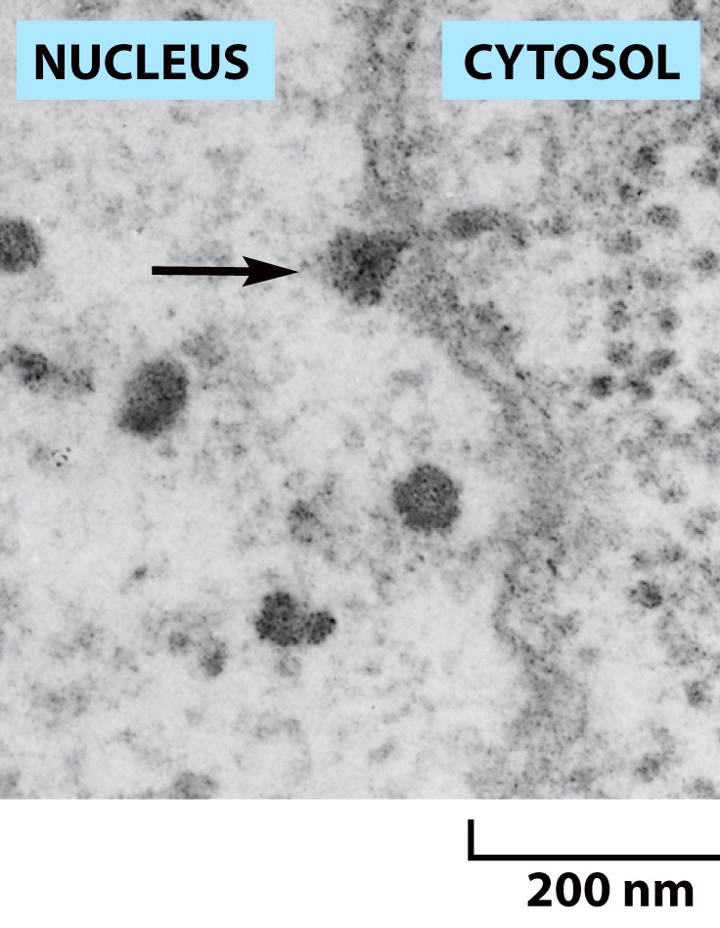

Proteínas con repetidos FG del poro (nucleoporinas)
Exportación del ARNm y la subunidad ribosómica 60S
NTF2
NXF
“Anillos de Balbiani”
Notes:
Fig. 5. FG repeat binding sites. A, schematic representation of the Mtr2-Mex67 multidomain organization (left) and Mtr2 (right) within the NPC showing the dual role of Mtr2. The FG nucleoporins are symbolized with brown filled circles along with the Mtr2 hydrophobic region (magenta) and additional core domain (green). B, the Mtr2-Mex67 heterodimer complex, viewed in two orientations rotated by ∼90°, is shown with the Mtr2 inserts 1 and 3 color-coded as in Fig. 1A. The crescent-shaped surface patches (white) indicate the location of each of the three FG repeat binding sites respectively located in Mtr2 (top, left), at the heterodimeric interface (top, center) and Mex67 (top, right). The bottom view indicates the position of the Mtr2 hydrophobic pocket (purple) relative to that of the FG repeat binding sites. Close-up views of C the Mtr2 FG binding site, the FG binding site located at the heteodimeric interface (D), and the Mex67 FG binding site (E). Mtr2 residues are labeled using the symbol #. The PGFGQQG peptide (white carbon atoms and green Phe side chain of the FG core) that is shown through a transparent surface was fitted into the Mex67 cavity based on the coordinates of the human TAP-p15 complex (accession code 1JN5).
Figure 6–39 Transport of a large mRNA molecule through the nuclear pore complex. (A) The maturation of an mRNA
molecule as it is synthesized by RNA polymerase and packaged by a variety of nuclear proteins. This drawing of an
unusually abundant RNA, called the Balbiani Ring mRNA, is based on EM micrographs such as that shown in (B). Balbiani
Rings are found in the cells of certain insects. (A, adapted from B. Daneholt, Cell 88:585–588, 1997. With permission from
Elsevier; B, from B.J. Stevens and H. Swift, J. Cell Biol. 31:55–77, 1966. With permission from The Rockefeller University Press.)

