Slide 1
Fotometría absoluta

Slide 2
Absolute vs. Differential Photometry
absolute photometry:
– requires aperture correction
– requires non-variable photometric standard stars
similar time and location on sky as science targets (same airmass)
ideally, with identical color (e.g., B–V) as science targets
– requires photometric weather conditions
– best attainable accuracy ~1%
– example applications:
color-magnitude diagrams
supernova flux measurements
differential photometry:
– usually, with respect to stars of known brightness in the same field • identical time and airmass
– subject to variability of reference stars
– best attainable accuracy ~0.001% (space), ~0.05% (ground)
– example applications:
searches for transiting planets

Slide 4
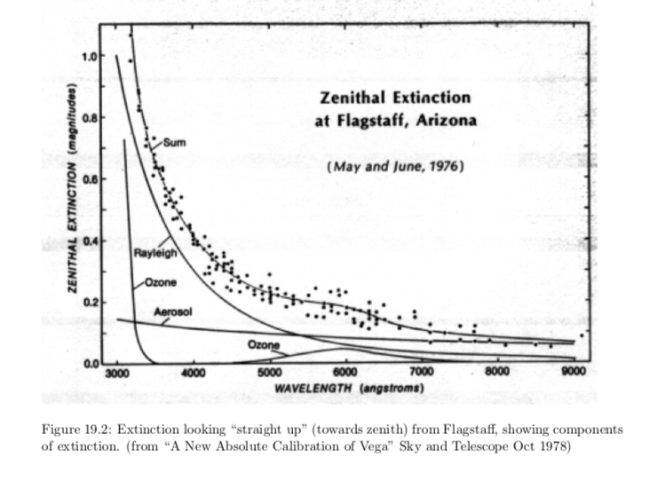

Slide 6
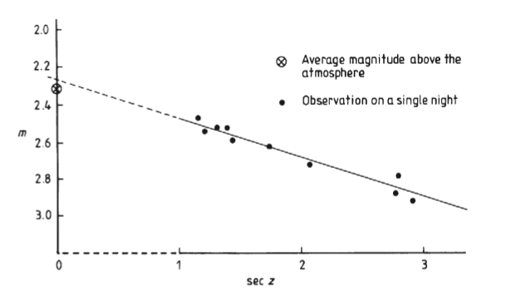
Extinción Atmosférica

Slide 7
Transformación a un sistema standard
Extinción
V₀ - mag. exoatmosférica
v - mag. Instrumental
b - mag. Instrumental
X - masa de aire
$κ_{v}^{′}$ y $κ_{v}^{′′}$- coef. de extinción de 1er
y 2^{do} orden
V_{s} - mag. corregida
C_{v} - const. (punto cero)
$V_{0}=v− X[κ_{v}^{′}$+$κ_{v}^{′′}\left(b−v\right)]$
$$X=\sec{Z}$$
Transformación a sistema fotométrico
$$V_{s}=V_{0}+ϵ{(B−V)}_{s}+C_{v}$$
Transformación conjunta
a₀ - punto cero
a₁ - término de color
a₂ - coef. de extinción de 1er orden
a₃ - coef. de extinción de 2^{do} orden
$$V_{s}=v+a_{0}+a_{1}{(B−V)}_{s}+a_{2}X+a_{3}X{(B−V)}_{s}$$
$$B_{s}=b+d_{0}+d_{1}{(B−V)}_{s}+d_{2}X+d_{3}X{(B−V)}_{s}$$
$$R_{s}=r+c_{0}+c_{1}{(V−R)}_{s}+c_{2}X+c_{3}X{(V−R)}_{s}$$

Slide 8
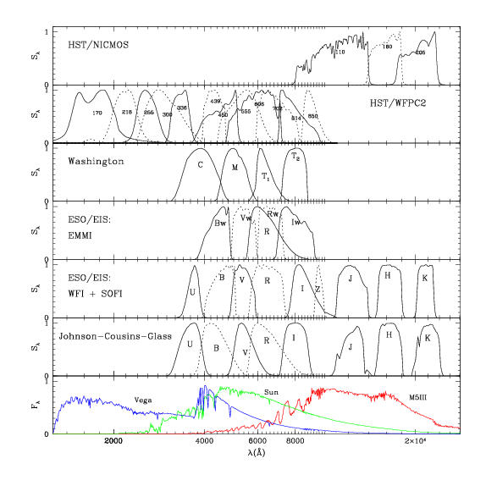
Sistemas fotométricos

Slide 9
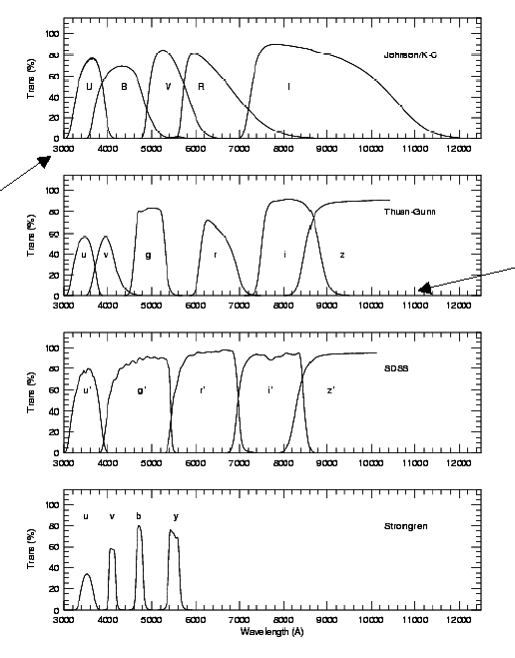
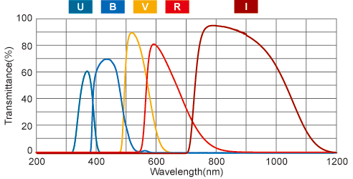
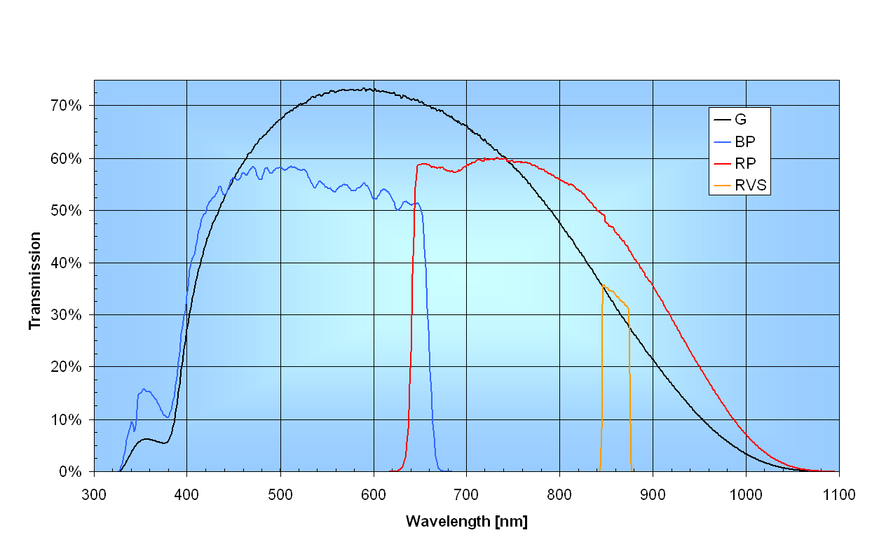

Slide 10
Estrellas standard
En el Sistema UBVRI de Johnson-Cousins
UBVRI photometric standard stars in the magnitude range 11.5-16.0 around the celestial equator - Landolt, A. U. – The Astronomical Journal, vol. 104, p. 340-371, 436-491 - 1992
UBVRI photometric standard stars around the sky at -50 declination – Landolt, A. U. - The Astronomical Journal, 133:2502-2523, 2007
UBVRI Photometric Standard Stars around the Sky at +50 deg Declination – Landolt, A. U. - The Astronomical Journal, 146, article id. 131, 41 pp., 2013
Faint UBVRI Standard Star Fields, Clem, J. L. ; Landolt, A. U. The Astronomical Journal, 146, article id. 88, 19 pp. (2013).

Slide 11
Bibliografía
The CCD Photometric Calibration Cookbook - Palmer & Davenhall (2001, Starlink Project) http://star-www.rl.ac.uk/docs/sc6.htx/sc6.html
Gallaway, An Introduction To Observational Astrophysics
Bessel 2005, Annual Review in Astronomy and Astrophysics

Slide 12
Paquetes de software para reducción de imágenes y fotometría

Slide 13
Paquetes
IRAF - Image Reduction and Analysis Facility: “is a collection of software written at the National Optical Astronomy Observatory (NOAO) geared towards the reduction of astronomical images in pixel array form. This is primarily data taken from imaging array detectors such as CCDs.” – Descontinuado con mantenimiento básico
https://iraf-community.github.io/
PyRAF: “based on the Python scripting language, is a command language for IRAF that can be used in place of the existing IRAF CL.” – Descontinuado con mantenimiento básico
https://iraf-community.github.io/pyraf.html
MIDAS: Developed by ESO (European Southern Observatory). The ESO-MIDAS system provides general tools for image processing and data reduction. It contains applications packages for stellar and surface photometry, image sharpening and decomposition, statistics and various others.
https://www.eso.org/sci/software/esomidas/
Astropy: The Astropy Project is a community effort to develop a core package for astronomy using the Python programming language and improve usability, interoperability, and collaboration between astronomy Python packages.
https://www.astropy.org/index.html
Photutils: is an affiliated package of Astropy that primarily provides tools for detecting and performing photometry of astronomical sources.
https://photutils.readthedocs.io/

